Slide 1
Foundations of Physical Chemistry Chapter 7: More Advanced Systems in Quantum
NeighborhoodGeeks

Slide 2
Expectation Value in Quantum Mechanics
When the wavefunction is not an eigenfunction of the operator being used, then no exact set of values can be obtained and instead only an expectation value can be established.
This value can be found by the following integral
$\left\langle O\right\rangle =\int{Ψ^{∗}\hat{O} Ψdτ }$over all space
Try finding the expected value of the position of a particle on a circular wire.

Slide 3
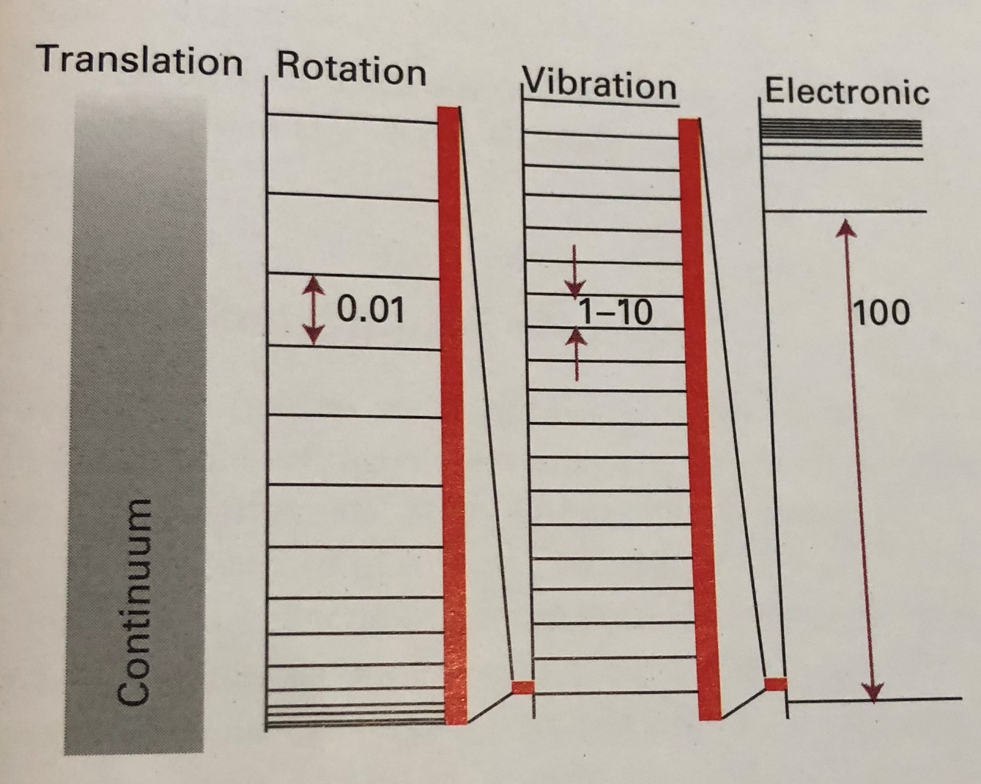
Stratification of Energy Levels

Slide 4
Particle in a Box
This model gives information about translational motion of a particle confined to a given space.
Once you have the solution in 1 dimension, you can just combine several of them to get higher dimension solution. But with higher dimensional systems, make sure to be wary of degeneracy.
How do you determine if you have degeneracy?
Symmetry = higher degree of degeneracy.
In 2 dimensions, a rectangle has no degeneracy, but a square has a lot of degeneracy.
In 3 dimensions, a cube has more degeneracy than a rectangular prism, etc.

Slide 5
Picture for Particle in a Box

Slide 6
Equations for Particle in a Box
For 1 dimension:
$E_{1Dbox}=\frac{h^{2}n^{2}}{8mL^{2}}, n>0$
$Ψ_{1Dbox}= \sqrt{\frac{2}{L}}sin(\frac{πn}{L}x)$
For more than 1 dimension:
$E_{nDbox}=E_{x}∗E_{y}∗E_{z}∗…E_{nthdimension}$
$Ψ_{nDbox}= Ψ_{x}∗Ψ_{y}∗Ψ_{z}∗…Ψ_{nthdimension}$

Slide 7
Common Uses for Particle in a Box
To determine the HOMO-LUMO transition for conjugated alkenes.
Example: find the HOMO-LUMO transition wavelength for 1,3-butadiene
Example: find the HOMO-LUMO transition wavelength for 1,3,5-hexatriene
Compare your answers to the known values
Whenever you do any of these problems always:
1. draw the energy ladder taking into consideration all degenerate states
2. find the number of particles that you are working with
3. label each level on the energy diagram with its corresponding n value
4. find the equation for energies in this system
5. find the difference in energies and set it equal to the energy of a photon:
$E_{photon}=\frac{hc}{λ}$

Slide 8
Rigid Rotor
This system gives information about rotational energy levels and their corresponding absolute energies.
Refers usually to electrons rotating around the nucleus of the atom.
The potential energy of the particle is constant and because of this, the potential can be designated as the zero.

Slide 9
Equations for Rigid Rotor
$E=\frac{J^{2}}{2mr^{2}}=\frac{J^{2}}{2I}=\frac{l\left(l+1\right)ħ^{2}}{2I}, l≥0$
In 3 dimensions, there are two parameters that define the position of the particle as it rotates, the azimuthal angle,$φ$, (how far around equatorially the particle is) and the colatitudal angle, $θ$, (how far around axially the particle is).
There is $2l+1$ degenerate states in this model depending upon the $l$ quantum #.
$J= \sqrt{l\left(l+1\right)ħ^{2}}$

Slide 10
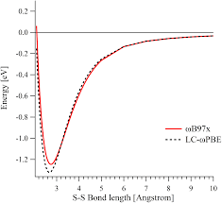
Quantum Harmonic Oscillator
Used to describe vibrational modes of molecules.
Can approximate bonds in molecules as mass-spring systems like in intro physics.
The potential energy of a mass-spring system is $V\left(x\right)=\frac{1}{2}kx^{2}$
Limited in utility because it assumes that bonds can be infinitely stretched without breaking, real molecules have a bond dissociation curve (below)

Slide 11
Equations for Quantum Harmonic Oscillator
$E=\left(v+\frac{1}{2}\right)hν, v≥0$
$ν=\frac{1}{2π}\sqrt{\frac{k_{bond}}{m}}$
Differences between energy levels are a constant, $hv$
There is a residual energy at quantum number = 0, this corresponds to the zero-point energy (ZPE). This transition in IR is forbidden. Will correspond to the absence of absorbance in a rotational-vibrational spectrum.

Slide 12
Hydrogen Atom Wavefunction
This is the only system that can be solved exactly, any element larger than hydrogen is impossible to solve exactly, we can only approximate after hydrogen.
This is because after the second electron is added to the atom, it becomes a three-body problem which cannot be solved. These electrons repel each other and that adds an additional term to the potential energy operator.
These equations will apply to all atoms/ions that are isoelectronic with hydrogen

Slide 13
Hydrogen Wavefunction Separation
There are two functions: radial and angular
$Ψ=R_{n,l}\left(r\right)∗Y_{l,m_{l}}\left(θ,φ\right)$
The electrons in the hydrogen atom has two ways to move, closer to the nucleus(radially) and around its sphere (angularly). These give rise to two distinct functions: radial and angular wavefunctions. The overall behavior of the electron is the summation of these two behaviors and therefore in the wavefunction they are multiplied. Like why particle in 3D is the product of the 1D case 3 times.

Slide 14
Hydrogen Wavefunction Separated Cont.
$Ψ_{H}=R_{n,l}\left(r\right)∗Y_{l,m_{l}}\left(θ,φ\right)$
The radial wavefunction depends upon n and l, these represent the principal and angular momentum quantum number. The n quantum number dictates how far away the electron is located from the nucleus. The l quantum number defines the shape of the orbital (s,p,d or f).
The angular wavefunction depends upon l and m_{l}, these represent the angular momentum and magnetic quantum numbers. The magnetic quantum number defines magnitude of the z-component of the angular momentum.

Slide 15
Equations for Hydrogen/Hydrogen-like Atom Wavefunction
$E_{n}=−\frac{hcR_{N}Z^{2}}{n^{2}}$
$R_{N}= \frac{μe^{4}}{8ε_{0}h^{3}c}$
$μ=\frac{m_{e}m_{N}}{m_{e}+m_{N}}$
$\frac{1}{λ}=R_{H}\left(\frac{1}{n_{i}^{2}}−\frac{1}{n_{f}^{2}}\right)$
$Ψ_{1s}=2{\left(\frac{1}{a_{0}^{3}}\right)}^{1/2}e^{−\frac{r}{a_{0}}}∗\frac{1}{2\sqrt{π}}$
$a_{0}=\frac{4πε_{0}ħ^{2}}{m_{e}e^{2}}$

Slide 16
Many-Electron Atoms
Previously there was only one electron to deal with, therefore we could effectively ignore the spin of the electrons.
Spin is an inherent property of the electron, it can be spin up or spin down. Though this is not true, to understand this concept you can visualize the electrons having their own clockwise or counterclockwise rotation.
The spin quantum number, s can only take on two values: ½ and - ½
Electrons that have spin up are denoted as α electrons and those with spin down are denoted as β electrons.

Slide 17
Pauli Principle
No more than 2 electrons can occupy a singular orbital and if two electrons do occupy it then their spins must be paired. This prevents 1s³ because then one of the electrons would have the spin as the others.

Slide 18
Aufbau Principle
The electrons will occupy the lowest energy orbitals first then the higher energy ones.
S then p then d then f.
The different orbitals are different energies due to electron-electron repulsion and the ability of s orbital electrons to penetrate closer to the nucleus.

Slide 19
Hund’s Rule
Within an s, p, d, and f orbital, electrons will try to maximize the number of unpaired electrons. The bus analogy, would rather sit by yourself than be forced to sit next to someone you don’t like.

Slide 20
Approximations for many-electron atoms
Two main ways of approximating energies for many-electron atoms:
Variation method
Perturbation theory
Variation method makes use of an exact Hamiltonian operator and an approximate wavefunction (typically a combination of hydrogen-like orbitals) to get the energy.
Perturbation theory makes use of an approximate Hamiltonian and an exact wavefunction.

Slide 21
Expected Energy Values and Dirac Notation
Because the wavefunction for multi-electron atoms (elements beyond hydrogen) cannot be solved for exactly, you can only approximate the energy for these systems.
The expected energy is given as:
$\left\langle E\right\rangle =\frac{\int{Θ^{∗}\hat{H} Θdτ}}{\int{Θ^{∗} Θdτ}}$
The wavefunctions used here are denoted as $Θ$ because they are approximate wavefunctions used with variation method.
The value gained here is always greater than the true value.

Slide 22
Expected Energy Values and Dirac Notation Cont.
With variation method, it is useful to throw in an adjustable parameter so that when you get the expected energy value, you can find the derivative and minimize the energy value that you get.
The more adjustable parameters you introduce the better the approximation gets.
Writing that integral is a pain so Dirac Notation is often used
$\int{Θ^{∗}\hat{H} Θdτ}$ in Dirac notation is $\left\langle Θ^{∗} | \hat{H} | Θ\right\rangle$ although oftentimes the * is removed from the wavefunction on the left because it is assumed to be the complex conjugate.
$\int{Θ^{∗} Θdτ}$ in Dirac notation is $\left\langle Θ^{∗} | Θ\right\rangle$

Slide 23
Expected Energy Value Example
Let’s return to the 1D box example, we know that the wavefunction for that is $Ψ=\sqrt{\frac{2}{L}}sin(\frac{πn}{L}x)$
One of the things we know about that is that at x = 0 or x = L, the wavefunction evaluates to 0. So lets design a function that does the same thing.
$Θ=\left(x\right)\left(x−L\right)=\left(x^{2}−Lx\right)=x^{2}−Lx$
$\left\langle E\right\rangle =\frac{\int{Θ^{∗}\hat{H} Θdτ}}{\int{Θ^{∗} Θdτ}}$

Slide 24
Expected Energy Value Example Cont.
$\left\langle E\right\rangle =\frac{\int{Θ^{∗}\hat{H} Θdτ}}{\int{Θ^{∗} Θdτ}}$
$Θ=x^{2}−Lx$
$\left\langle E\right\rangle =\frac{\int_{0}^{L}{x^{2}−Lx ∗\left(−\frac{ħ^{2}}{2m}\right)∗\frac{d^{2}}{dx^{2}}\left(x^{2}−Lx\right)dx}}{\int_{0}^{L}{\left(x^{2}−Lx\right)\left(x^{2}−Lx\right)dx}}$
$\left\langle E\right\rangle =−\frac{ħ^{2}}{2m} ∗ \frac{\int_{0}^{L}{x^{2}−Lx∗2dx}}{\int_{0}^{L}{{\left(x^{2}−Lx\right)}^{2}dx}}=−\frac{ħ^{2}}{2m}∗\frac{−\frac{L^{3}}{3}}{\frac{L^{5}}{30}}=−\frac{ħ^{2}}{2m}∗−\frac{10}{L^{2}}=\frac{5ħ^{2}}{L^{2}m}$
Compared to $\frac{h^{2}n^{2}}{8mL^{2}}$ for the actual solution
Variation method problems are the same except you would put an adjustable parameter, k and take the derivative of the expected energy expression and find where it is equal to 0.

