Slide 1
Foundations of Physical Chemistry Chapter 6: Introduction to Quantum
NeighborhoodGeeks

Slide 2
Some definitions
Wavefunction: A mathematical formulation for the behavior and properties of electrons which behave according to certain postulates. These are typically denoted with the Greek letter, psi, or Ψ
Operator: A mathematical transformation that gives a certain physical quantity, there are operators that give position, energy, etc.
Eigenfunction: A function that when an operator operates on it results in an eigenvalue and returns the original function.
Eigenvalue: the acceptable value(s) that a physical quantity may take on dependent on the quantum state.
Hamiltonian: The energy operator, this operator gives the energy of a particular system when used on the wavefunction (Schrӧdinger equation).
Degenerate state: states that have the same energy values
Complex conjugate: The wavefunction that has i replaced with –i (at least for this course)

Slide 3
Postulates of Quantum Mechanics
All physical observables (physical property that can be observed) of a system is contained in the wavefunction.
The wavefunction times its complex conjugate represents a probability density for finding a particle at a particular range of values. (Born interpretation)
Wavefunctions must be continuous and real-valued
Wavefunctions must be normalized and orthogonal
Normalized means that the integral of the wavefunction of the same quantum number over all possible values (frequently referred to as ‘all space’) is equal to 1.
Orthogonal means that the integral of the wavefunction at one quantum number times the wavefunction at another quantum number over all space is equal to 0.

Slide 4
What does Orthogonal and Normalized Really Mean?
The Born interpretation states that the wavefunction times its complex conjugate is the probability density function of finding a particle in that system at a particular range of values.
Normalized means that the probability of finding a particle in between all possible values the system can take on is 1, basically means that if you looked at every possible value you would be guaranteed to find the particle.
Orthogonal means that if you have two particles at two different quantum states, they will not be found in the same position ever (because they are in different states). Basically an impossible game of hide and seek.

Slide 5
An Analogy for Orthogonality and Normality
Imagine you are playing hide and seek with your friend in NY state, assuming your friend that you’re looking for is stationary, what is the probability of you finding him/her if you searched every possible location… obviously 100% because you searched all possible locations, you looked at all possible position values he/she could’ve had within the same state!
Now imagine a second game where your friend really wants to win so he crosses over to NJ. Assuming you can only look for him/her in NY, what is the probability of you finding him/her? Obviously 0% because your friend isn’t in NY, your friend is in NJ. Your friend is in another state!

Slide 6
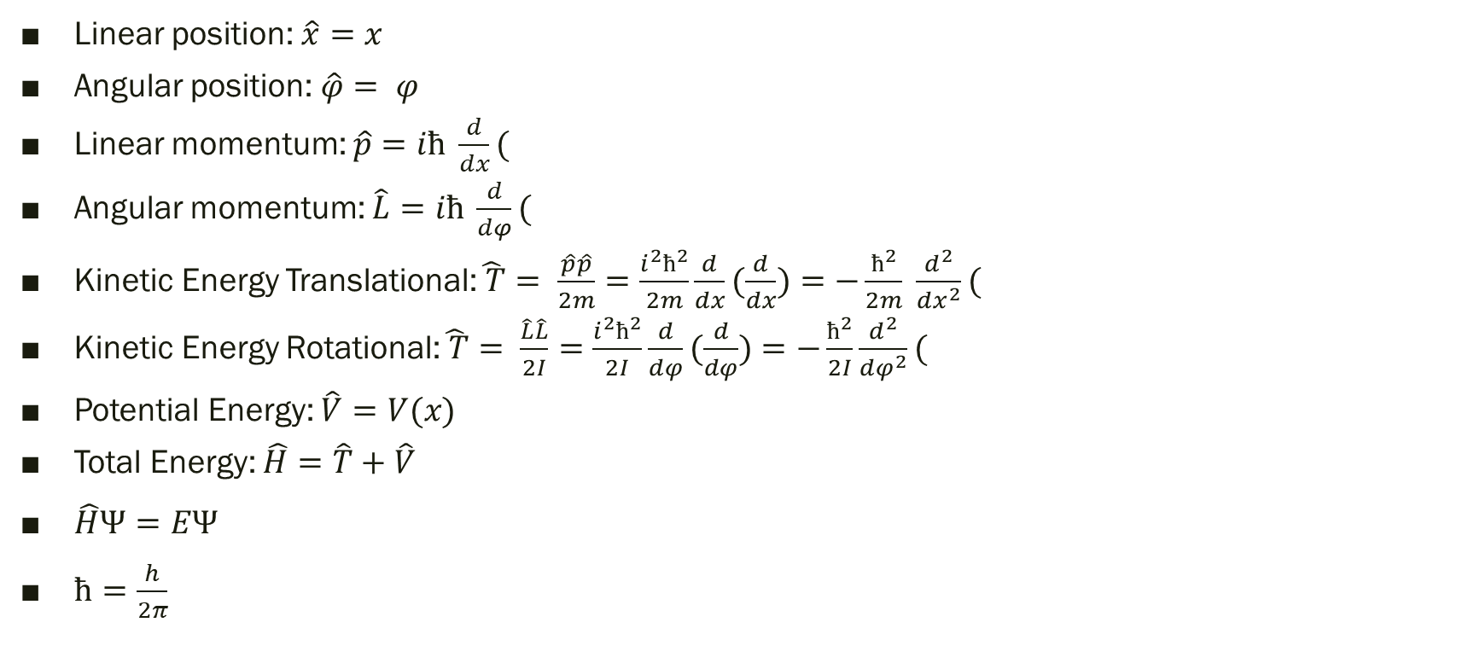
List of Important Operators and Equations in Quantum
Linear position: $\hat{x}=x$
Angular position: $\hat{φ}= φ$
Linear momentum: $\hat{p}=iħ \frac{d}{dx}($
Angular momentum: $\hat{L}=iħ \frac{d}{dφ}($
Kinetic Energy Translational:$\hat{ T}= \frac{\hat{p}\hat{p}}{2m}=\frac{i^{2}ħ^{2}}{2m}\frac{d}{dx}(\frac{d}{dx})=−\frac{ħ^{2}}{2m} \frac{d^{2}}{dx^{2}}($
Kinetic Energy Rotational:$\hat{ T}= \frac{\hat{L}\hat{L}}{2I}=\frac{i^{2}ħ^{2}}{2I}\frac{d}{dφ}(\frac{d}{dφ})=−\frac{ħ^{2}}{2I}\frac{d^{2}}{dφ^{2}}($
Potential Energy: $\hat{V}=V(x)$
Total Energy: $\hat{H}=\hat{T}+\hat{V}$
$\hat{H}Ψ=EΨ$
$ħ=\frac{h}{2π}$

Slide 7
Schrӧdinger equation
Very important equation for Quantum Mechanics
$\hat{H}Ψ=EΨ$
Where $\hat{H}$ is the Hamiltonian operator, or the total energy operator
E is the energy eigenvalues, all possible values of energy possible at a given quantum number, usually denoted as n.
This equation in words means:
The total energy of the system at a particular quantum number, n, is equal to the sum of the kinetic and potential energy of that state.

Slide 8
An example system
Imagine a particle that is confined to a circular path of radius R that is free to move. This is the Particle on a circular wire system.
Useful for aromatic compounds like Benzene.
The particle on a circular wire has no potential energy, V(x) = 0 J.
The particle has some angular momentum, l and no translational motion, therefore its kinetic energy is solely from its angular motion.

Slide 9

Particle on a Circular Wire
$\hat{H}Ψ=EΨ$
$\left(\hat{T}+\hat{V}\right)Ψ=EΨ$
$\hat{V}=0$
$\hat{T}=\frac{i^{2}ħ^{2}}{2I} \frac{d^{2}}{dφ^{2}}( =−\frac{ħ^{2}}{2I} \frac{d^{2}}{dφ^{2}}($
$−\frac{ħ^{2}}{2I} \frac{d^{2}Ψ}{dφ^{2}}=EΨ$
Isolate the second derivative
$\frac{d^{2}Ψ}{dφ^{2}}=−\frac{2IE}{ħ^{2}}Ψ$

Slide 10
Particle on a Circular Wire Cont.
$\frac{d^{2}Ψ}{dφ^{2}}=−\frac{2IE}{ħ^{2}}Ψ$
We are looking for a function that when the second derivative is taken, it returns a constant and the original function:
There are two options:
e^x
Cos or sin
Let’s test the exponential function first to avoid negatives
Want to make the most generalized exponential function:
Let’s suppose that $Ψ=Ae^{kφ}$

Slide 11
Testing the Exponential Solution
$\frac{d^{2}Ψ}{dφ^{2}}=−\frac{2IE}{ħ^{2}}Ψ$
$Ψ=Ae^{kφ}$
$\frac{d^{2}Ψ}{dφ^{2}}=k^{2}Ae^{kφ}=−\frac{2IE}{ħ^{2}}Ψ=−\frac{2IE}{ħ^{2}}Ae^{kφ}$
Isolate k to find more information about our wavefunction
$k= \sqrt{−\frac{2IE}{ħ^{2}}}=i \sqrt{\frac{2IE}{ħ^{2}}}$
$Ψ=Ae^{i \sqrt{\frac{2IE}{ħ^{2}}}φ}$

Slide 12
Test Endpoints
$φ$ is the angle measure from the center of the circle to the particle along the circular path, therefore $φ=0 and φ=2π$ are the same position.
Therefore the value of $Ψ\left(0\right)= Ψ\left(2π\right)$

Slide 13
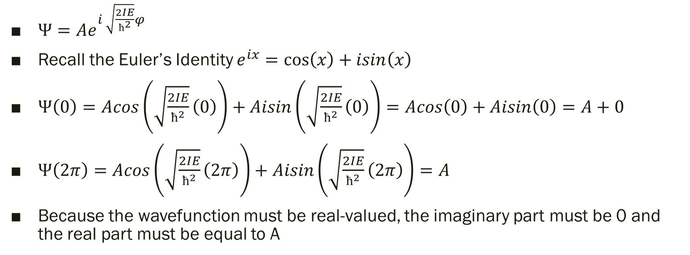
Testing Endpoints Cont.
$Ψ=Ae^{i \sqrt{\frac{2IE}{ħ^{2}}}φ}$
Recall the Euler’s Identity $e^{ix}=\cos\left(x\right)+isin\left(x\right)$
$Ψ\left(0\right)=Acos\left(\sqrt{\frac{2IE}{ħ^{2}}}\left(0\right)\right)+Aisin\left(\sqrt{\frac{2IE}{ħ^{2}}}\left(0\right)\right)=Acos\left(0\right)+Aisin\left(0\right)=A+0$
$Ψ\left(2π\right)=Acos\left(\sqrt{\frac{2IE}{ħ^{2}}}\left(2π\right)\right)+Aisin\left(\sqrt{\frac{2IE}{ħ^{2}}}\left(2π\right)\right)=A$
Because the wavefunction must be real-valued, the imaginary part must be 0 and the real part must be equal to A

Slide 14
Testing Endpoints Cont.
$Acos\left(\sqrt{\frac{2IE}{ħ^{2}}}\left(2π\right)\right)=A=Acos\left(0+2πn\right)$
Cos(x) evaluates to 1 at 0 and all $2π$ intervals.
$\sqrt{\frac{2IE}{ħ^{2}}}\left(2π\right)=2πn$
Isolate E so we can get the Energy eigenvalues
$\sqrt{\frac{2IE}{ħ^{2}}}=n$
$\frac{2IE}{ħ^{2}}=n^{2}$
$E=\frac{n^{2}ħ^{2}}{2I}$
This equation works for all n because of cos(x) always evaluates to 1 when x is a multiple of $2π$.
That means that this system has a high degree of degeneracy because both positive and negative integers give the same energy value!

Slide 15
Solving the Rest of the Wavefunction
$Ψ=Ae^{i \sqrt{\frac{2IE}{ħ^{2}}}φ}=Ae^{inφ}$
Let’s solve for A by doing a normalization integral
$\int_{0}^{2π}{Ae^{inφ}∗Ae^{−inφ}dφ=1}$
A is a constant therefore it can be taken out of the integrand
The bounds are 0 to $2π$ because those are all the possible angle measures in a circle.
$A^{2}\int_{0}^{2π}{e^{inφ}∗\frac{1}{e^{inφ}}dφ=1}$
Recall that negative exponents bring the term to the denominator

Slide 16
Solving the Rest of the Wavefunction Cont.
$A^{2}\int_{0}^{2π}{e^{inφ}∗\frac{1}{e^{inφ}}dφ=1}$
$A^{2}\int_{0}^{2π}{dφ=1}$
$A^{2}∗\left(2π\right)=1$
$A^{2}=\frac{1}{2π}$
$A= \sqrt{\frac{1}{2π}}$

Slide 17
Testing Orthogonality
So far we have the following information about our system:
$Ψ= \sqrt{\frac{1}{2π}}e^{inφ}$
$E=\frac{n^{2}ħ^{2}}{2I}$
But all wavefunctions need to be orthonormal, right now it is normalized, but is the wavefunction orthogonal?

Slide 18
Testing Orthogonality Cont.
$Ψ= \sqrt{\frac{1}{2π}}e^{inφ}$
Let’s test n = 1 and n = 2
$\int_{0}^{2π}{\sqrt{\frac{1}{2π}}}e^{iφ}∗\sqrt{\frac{1}{2π}}e^{−2iφ}dφ=0$
$\frac{1}{2π}\int_{0}^{2π}{e^{iφ}∗\frac{1}{{\left(e^{iφ}\right)}^{2}}dφ=0}$
$\frac{1}{2π}\int_{0}^{2π}{e^{−iφ}dφ}=0$
$\frac{1}{2π}\left(−\frac{1}{i}e^{−i\left(2π\right)}+\frac{1}{i}e^{−i\left(0\right)}\right)=\frac{1}{2π}(−\frac{1}{i}\left(\cos\left(−2π\right)+isin\left(−2π\right)\right)+\frac{1}{i}\left(\cos\left(0\right)+isin\left(0\right)\right)$
$\frac{1}{2π}\left(−\frac{1}{i}\left(1+0\right)+\frac{1}{i}\left(1+0\right)\right)=\frac{1}{2π}\left(−\frac{1}{i}+\frac{1}{i}\right)=\frac{1}{2π}\left(0\right)=0=0$
Therefore the wavefunction is orthogonal

Slide 19

Equations to Know for Particle on a Circular Wire
$Ψ= \sqrt{\frac{1}{2π}}e^{inφ}$, n can be any integer value of n
$E=\frac{n^{2}ħ^{2}}{2I}$
$I=mr^{2}$

Slide 20
Let’s Apply the Particle on a Circular Wire
Let’s calculate the HOMO-LUMO transition wavelength for Benzene.
Here are the givens:
Mass of electron = 9.11 x 10⁻³¹ kg
Radius of benzene = 1.39 angstroms = 1.39 x 10⁻¹⁰m
ħ = 1.055 x 10⁻³⁴Js

Slide 21
Prediction using Particle on a Wire
$E=\frac{n^{2}ħ^{2}}{2I}$
But what is our n value for benzene?
For that we need to construct an energy ladder taking into consideration degenerate energy levels.
How many electrons are in the wire?
For each double bond there are 2 electrons
3 double bonds therefore there are 6 electrons

Slide 22
Energy ladder for Benzene

Slide 23
Calculation of the HOMO-LUMO Transition
$E=\frac{n^{2}ħ^{2}}{2I}$
Now we know that the n of the HOMO is 1 and the n for LUMO is 2.
The energy of the photon needed to excite the HOMO electrons to the LUMO would need to have an energy that is equal to the difference in energy between HOMO and LUMO.
$∆E=\frac{hc}{λ}=\frac{n_{LUMO}^{2}ħ^{2}}{2I} −\frac{n_{HOMO}^{2}ħ^{2}}{2I}=\frac{ħ^{2}}{2I}∗\left(n_{LUMO}^{2}−n_{HOMO}^{2}\right)$
$∆E=\frac{ħ^{2}}{2I}∗\left(n_{LUMO}^{2}−n_{HOMO}^{2}\right)$

Slide 24
Calculation of the HOMO-LUMO Transition Cont.
$∆E=\frac{ħ^{2}}{2I}∗\left(n_{LUMO}^{2}−n_{HOMO}^{2}\right)=\frac{2πħc}{λ}$
$λ=\frac{2πħc}{\frac{ħ^{2}}{2I}\left(n_{LUMO}^{2}−n_{HOMO}^{2}\right)}$
Substitute known values making sure to use kilogram, meter, second units and then converting to nm
$λ_{calc}=209.7 nm$
The actual lambda for HOMO-LUMO transition is 260 nm

