Slide 1
Foundations of Physical Chemistry Chapter 5: Kinetics
NeighborhoodGeeks

Slide 2
What is Kinetics
Kinetics discusses how fast a reaction occurs (think kinetic energy).
For a reaction to occur a few conditions must be met:
  Molecules need to collide
    With the right energy (think speed)
    With the right orientation
  The reaction must be favorable at that condition of temperature and pressure
So far we have only discussed if a reaction is favorable (ΔG is negative), but not how fast that reaction occurs.
Just because something is favorable DOES NOT mean it will occur quickly (the transition of diamond to graphite is favorable but you don’t see wedding rings becoming pencil lead).

Slide 3
How Are Reaction Kinetics Studied?
Reaction kinetics can be assessed in two ways:
  Rate of formation of a product
  Rate of disappearance of a reactant
The easiest way to do this is a colorimetric assay (a reaction that makes a colored product)
Reactions can also be followed using spectroscopy like NMR by looking at the rate of disappearance of a reactant peak/ appearance of a product peak.

Slide 4
Some Vocabulary
Rate Law = the mathematical equation that represents how fast a reaction occurs depending upon the rate constant and the concentration of reactants (or products)
Order = the exponent on the reactant in the rate expression
Reactive intermediate = a chemical species that is both created and consumed during the course of a reaction

Slide 5
Reaction Mechanisms
Unlike in organic chemistry, reaction mechanisms in the kinetics context do not have a bunch of arrows all over the place.
Instead, the reaction is broken down to elementary steps
Typically these steps involve a bimolecular collision (collision of two molecules)
Reaction mechanisms can be supported, but NEVER proved.
Steps involving more than two molecules colliding is exceptionally rare and typically there is a better reaction mechanism proposal.

Slide 6
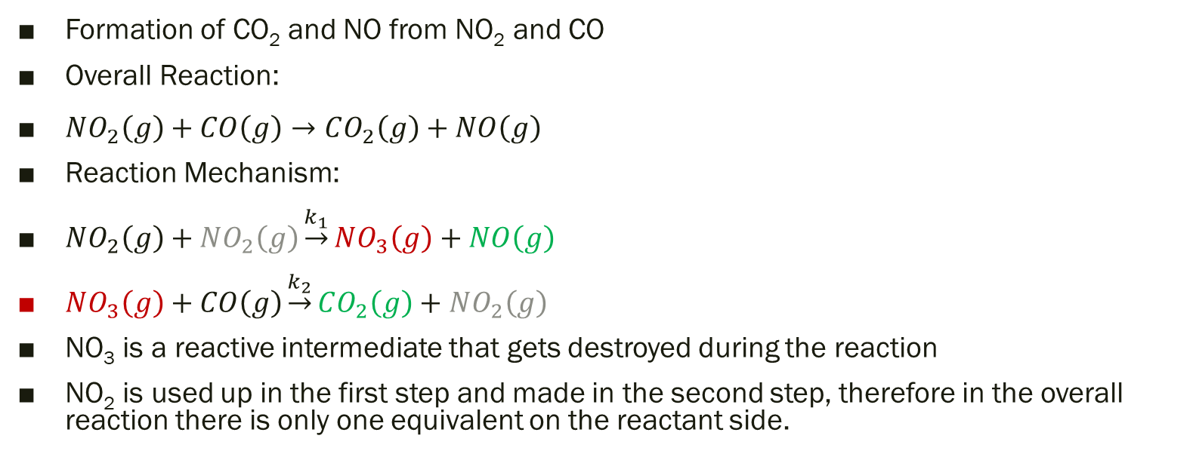
Example of a Reaction Mechanism
Formation of CO₂ and NO from NO₂ and CO
Overall Reaction:
$NO_{2}\left(g\right)+CO\left(g\right)→CO_{2}\left(g\right)+NO\left(g\right)$
Reaction Mechanism:
$NO_{2}\left(g\right)+NO_{2}\left(g\right)\underset{→}{k_{1}}NO_{3}\left(g\right)+NO\left(g\right)$
$NO_{3}\left(g\right)+CO\left(g\right)\underset{→}{k_{2}}CO_{2}\left(g\right)+NO_{2}\left(g\right)$
NO₃ is a reactive intermediate that gets destroyed during the reaction
NO₂ is used up in the first step and made in the second step, therefore in the overall reaction there is only one equivalent on the reactant side.

Slide 7
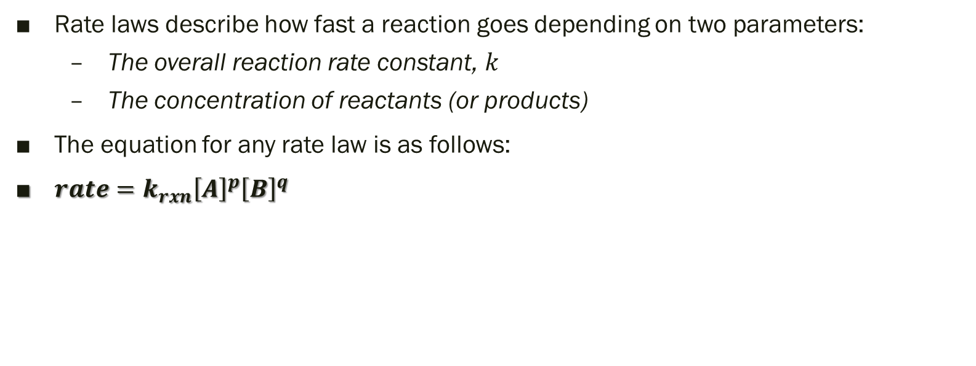
Rate Laws
Rate laws describe how fast a reaction goes depending on two parameters:
  The overall reaction rate constant, $k$
  The concentration of reactants (or products)
The equation for any rate law is as follows:
$rate=k_{rxn}{\left[A\right]}^{p}{\left[B\right]}^{q}$

Slide 8
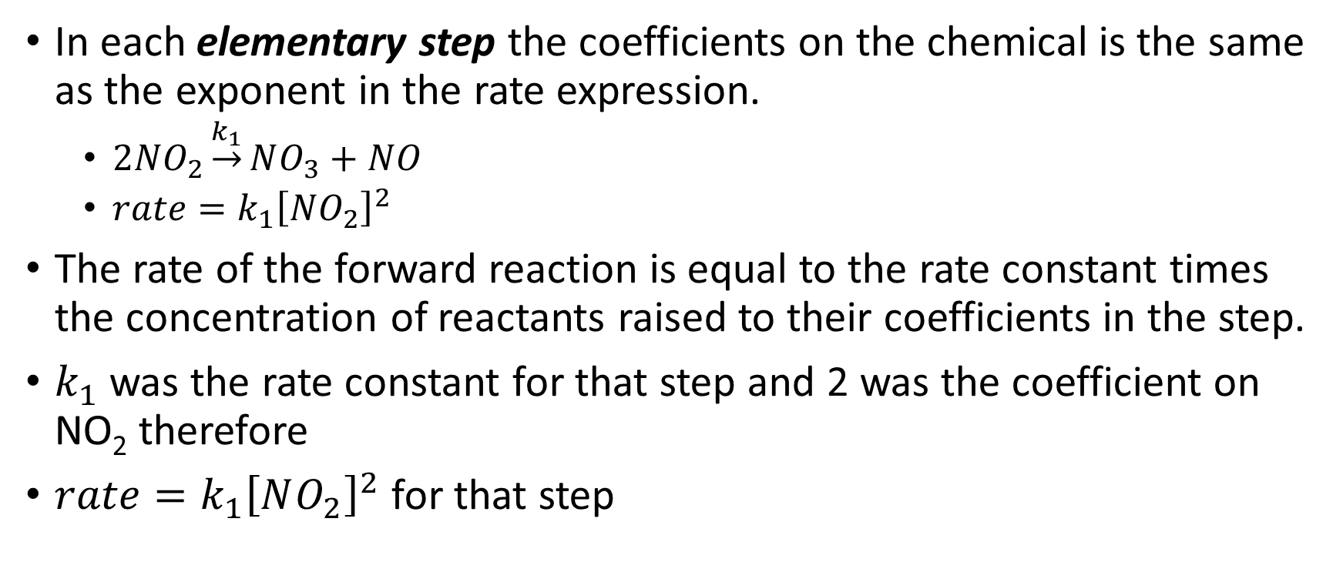
How to Determine the Rate Law Given the Reaction Mechanism
In each elementary step the coefficients on the chemical is the same as the exponent in the rate expression.
  $2NO_{2}\underset{→}{k_{1}}NO_{3}+NO$
  $rate=k_{1}{\left[NO_{2}\right]}^{2}$
The rate of the forward reaction is equal to the rate constant times the concentration of reactants raised to their coefficients in the step.
$k_{1}$ was the rate constant for that step and 2 was the coefficient on NO₂ therefore
$rate=k_{1}{\left[NO_{2}\right]}^{2}$ for that step

Slide 9
How to Determine the Rate Law Given the Reaction Mechanism Cont.
The overall reaction rate law can be determined using two key assumptions:
  The steady-state approximation
  The rate-limiting step approximation
The steady-state approximation states that the rate of destruction of a reactive intermediate (like NO₃) is equal to the rate of creation of said intermediate.
The rate-limiting step approximation states that the overall rate is determined primarily by the slow step.

Slide 10
Example of Determining a Rate Law
Determine the rate law for the following reaction:

Slide 11
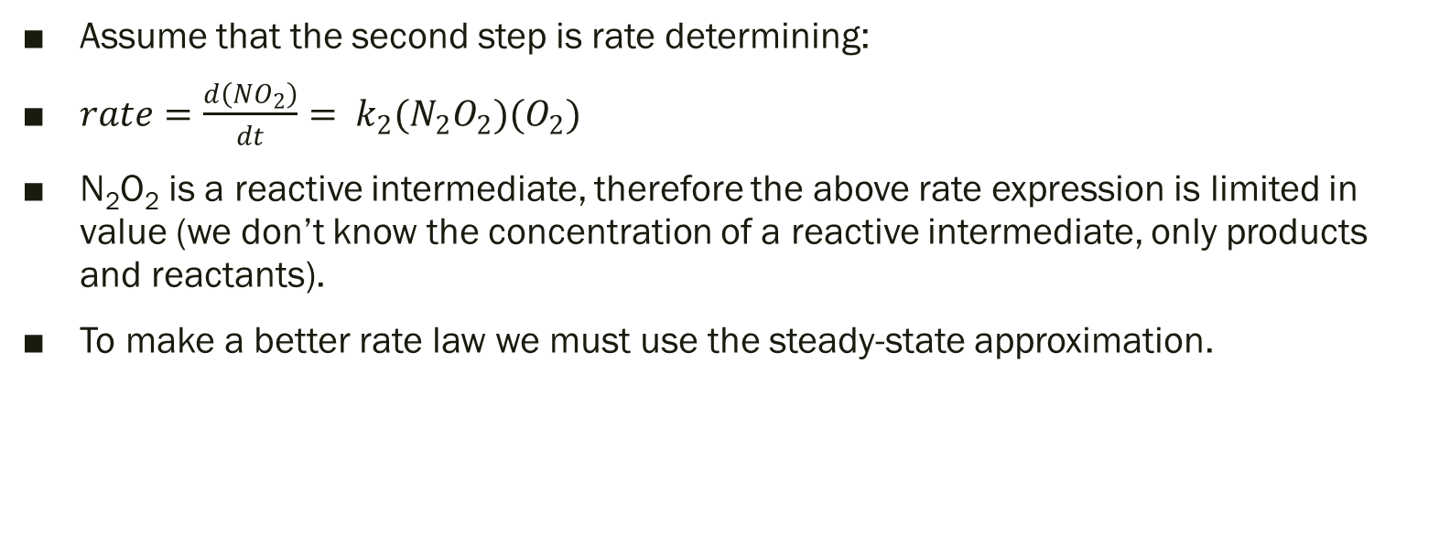
Example of Determining Rate Law
Assume that the second step is rate determining:
$rate=\frac{d\left(NO_{2}\right)}{dt}= k_{2}(N_{2}O_{2})(O_{2})$
N₂O₂ is a reactive intermediate, therefore the above rate expression is limited in value (we don’t know the concentration of a reactive intermediate, only products and reactants).
To make a better rate law we must use the steady-state approximation.

Slide 12
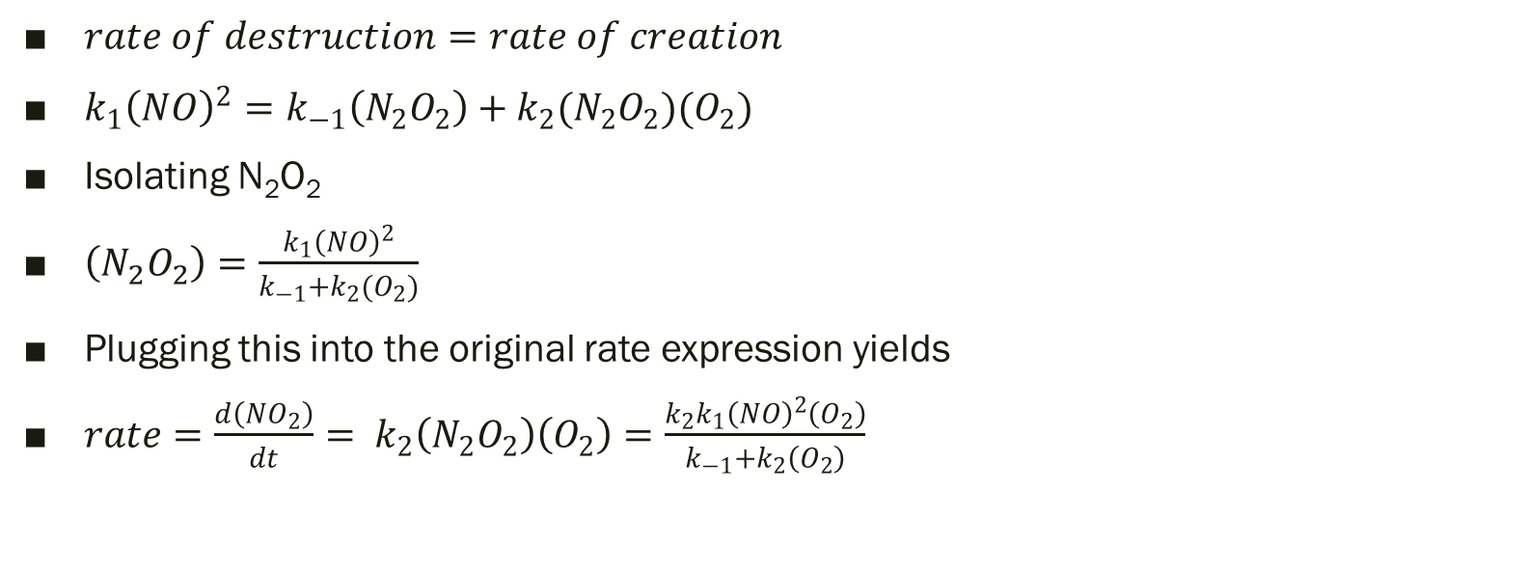
Example of Determining Rate Law
$rate of destruction=rate of creation$
$k_{1}{\left(NO\right)}^{2}=k_{−1}\left(N_{2}O_{2}\right)+k_{2}(N_{2}O_{2})(O_{2})$
Isolating N₂O₂
$\left(N_{2}O_{2}\right)=\frac{k_{1}{\left(NO\right)}^{2}}{k_{−1}+k_{2}(O_{2})}$
Plugging this into the original rate expression yields
$rate=\frac{d\left(NO_{2}\right)}{dt}= k_{2}\left(N_{2}O_{2}\right)\left(O_{2}\right)=\frac{k_{2}k_{1}{\left(NO\right)}^{2}\left(O_{2}\right)}{k_{−1}+k_{2}\left(O_{2}\right)}$

Slide 13
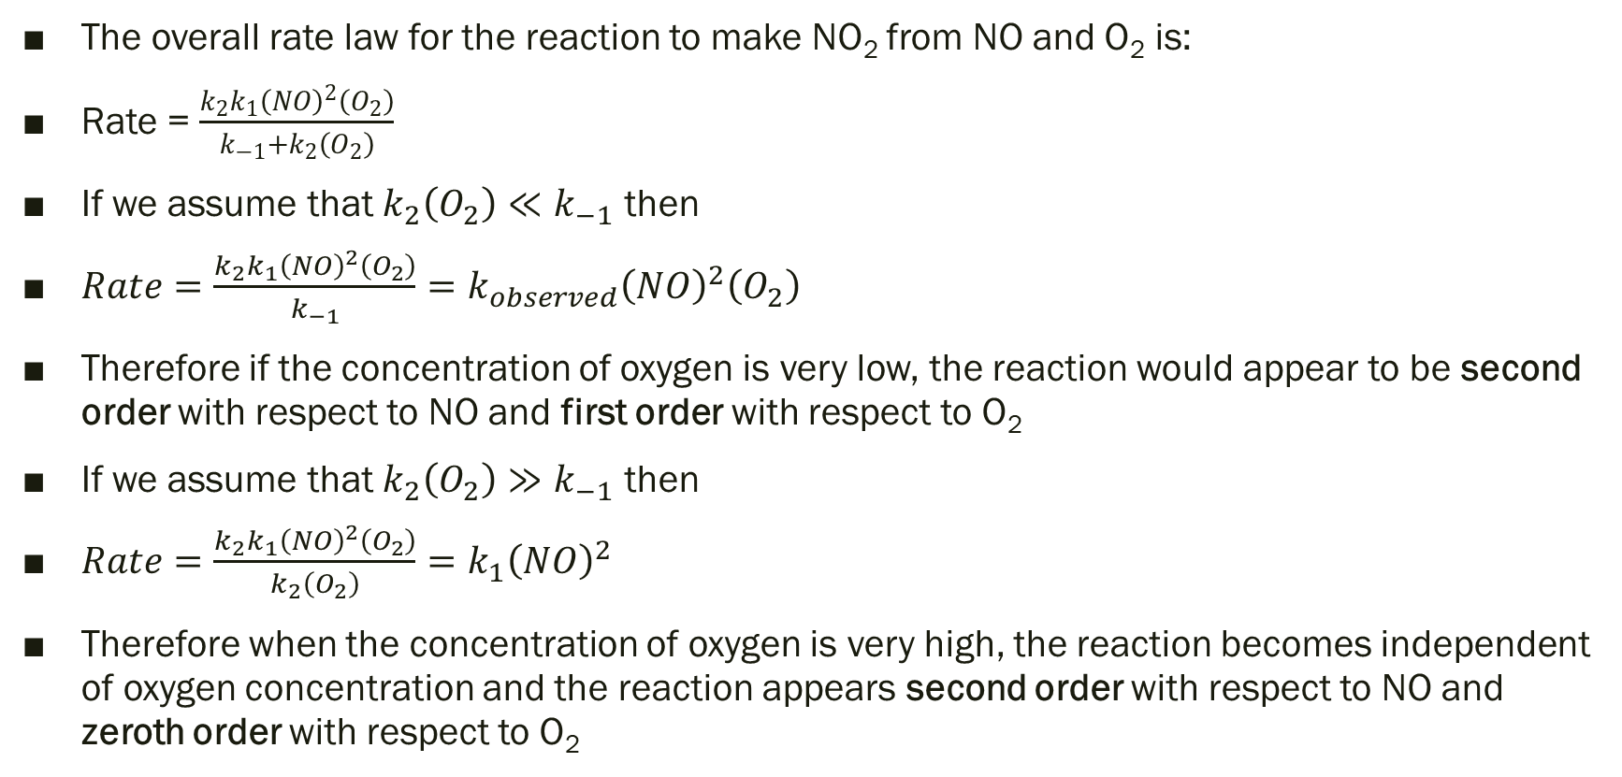
Evaluating Conditions
The overall rate law for the reaction to make NO₂ from NO and O₂ is:
Rate = $\frac{k_{2}k_{1}{\left(NO\right)}^{2}\left(O_{2}\right)}{k_{−1}+k_{2}\left(O_{2}\right)}$
If we assume that $k_{2}\left(O_{2}\right)≪k_{−1}$ then
$Rate=\frac{k_{2}k_{1}{\left(NO\right)}^{2}\left(O_{2}\right)}{k_{−1}}=k_{observed}{\left(NO\right)}^{2}\left(O_{2}\right)$
Therefore if the concentration of oxygen is very low, the reaction would appear to be second order with respect to NO and first order with respect to O₂
If we assume that $k_{2}\left(O_{2}\right)≫k_{−1}$ then
$Rate=\frac{k_{2}k_{1}{\left(NO\right)}^{2}\left(O_{2}\right)}{k_{2}\left(O_{2}\right)}=k_{1}{\left(NO\right)}^{2}$
Therefore when the concentration of oxygen is very high, the reaction becomes independent of oxygen concentration and the reaction appears second order with respect to NO and zeroth order with respect to O₂

Slide 14
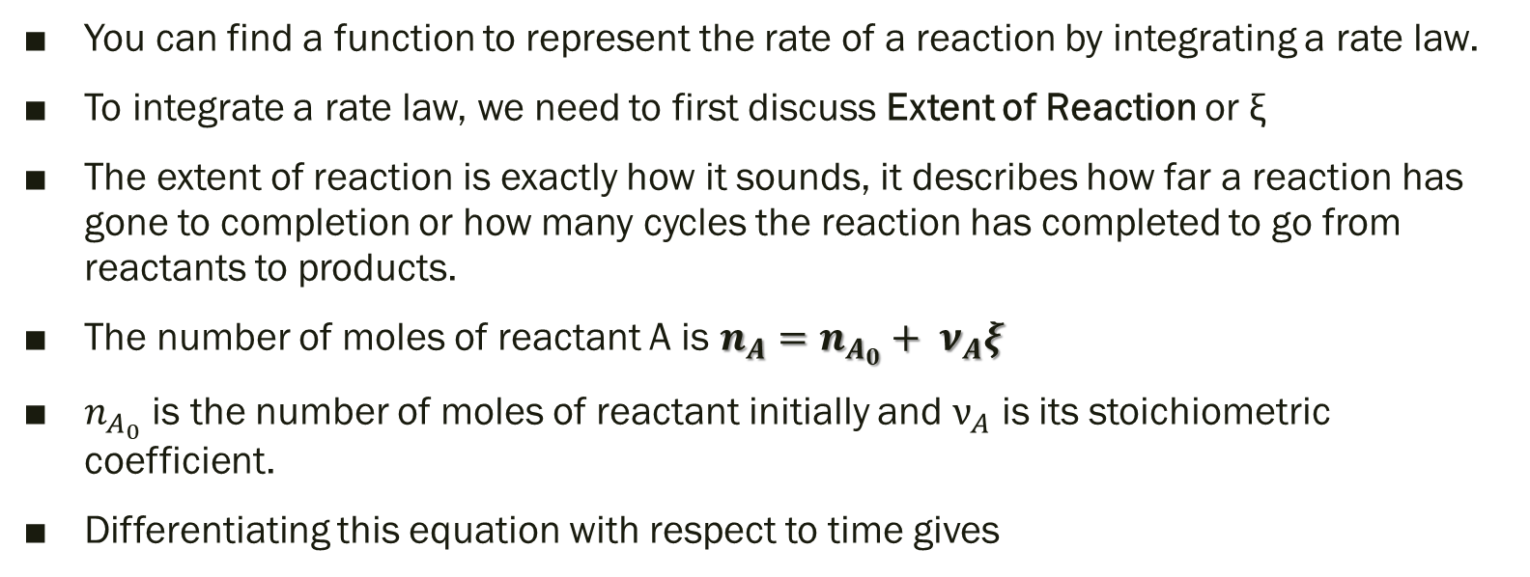
Integrated Rate Laws
You can find a function to represent the rate of a reaction by integrating a rate law.
To integrate a rate law, we need to first discuss Extent of Reaction or ξ
The extent of reaction is exactly how it sounds, it describes how far a reaction has gone to completion or how many cycles the reaction has completed to go from reactants to products.
The number of moles of reactant A is $n_{A}=n_{A_{0}}+ ν_{A}ξ$
$n_{A_{0}}$ is the number of moles of reactant initially and $ν_{A}$ is its stoichiometric coefficient.
Differentiating this equation with respect to time gives

Slide 15
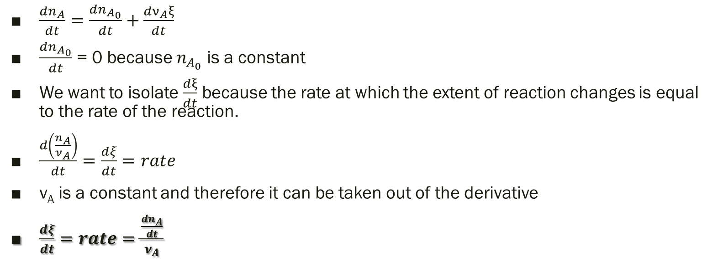
Integrated Rate Laws Cont.
$\frac{dn_{A}}{dt}=\frac{dn_{A_{0}}}{dt}+\frac{{dν}_{A}ξ}{dt}$
$\frac{dn_{A_{0}}}{dt}$ = 0 because $n_{A_{0}}$ is a constant
We want to isolate $\frac{dξ}{dt}$ because the rate at which the extent of reaction changes is equal to the rate of the reaction.
$\frac{d\left(\frac{n_{A}}{ν_{A}}\right)}{dt}=\frac{dξ}{dt}=rate$
ν_{A} is a constant and therefore it can be taken out of the derivative
$\frac{dξ}{dt}=rate=\frac{\frac{dn_{A}}{dt}}{ν_{A}}$

Slide 16
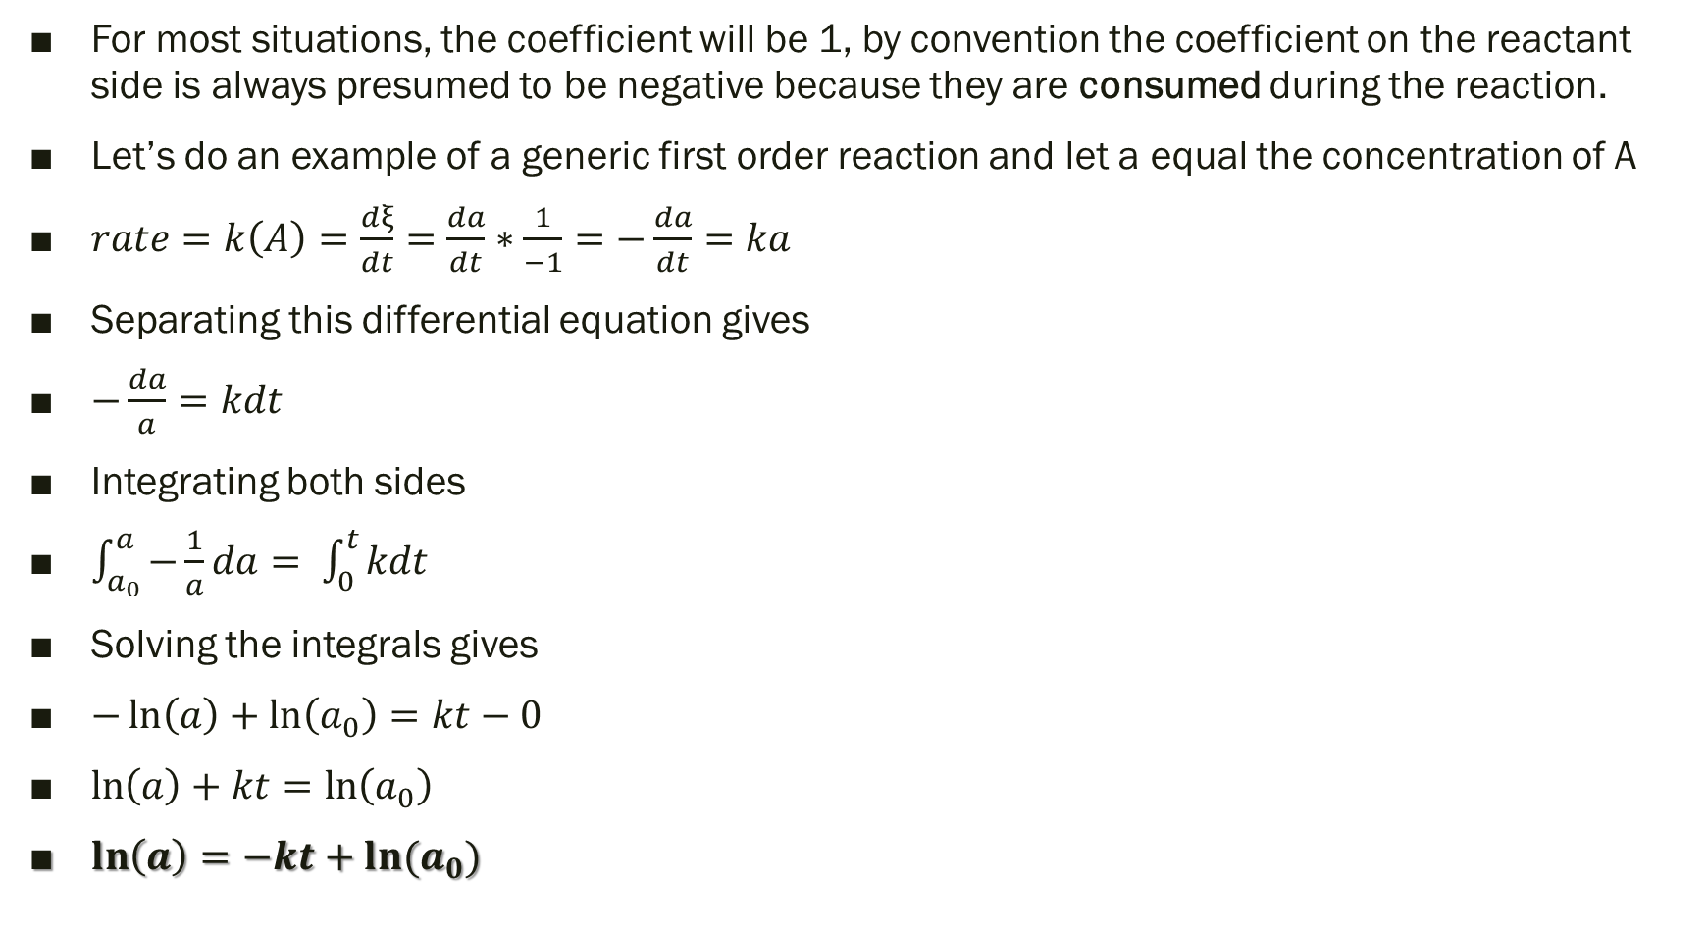
Example of Finding Integrated Rate Laws
For most situations, the coefficient will be 1, by convention the coefficient on the reactant side is always presumed to be negative because they are consumed during the reaction.
Let’s do an example of a generic first order reaction and let a equal the concentration of A
$rate=k\left(A\right)=\frac{dξ}{dt}=\frac{da}{dt}∗\frac{1}{−1}=−\frac{da}{dt}=ka$
Separating this differential equation gives
$−\frac{da}{a}=kdt$
Integrating both sides
$\int_{a_{0}}^{a}{−\frac{1}{a}da}= \int_{0}^{t}{kdt}$
Solving the integrals gives
$−\ln\left(a\right)+\ln\left(a_{0}\right)=kt−0$
$\ln\left(a\right)+kt=\ln\left(a_{0}\right)$
$\ln\left(a\right)=−kt+ln⁡(a_{0})$

Slide 17
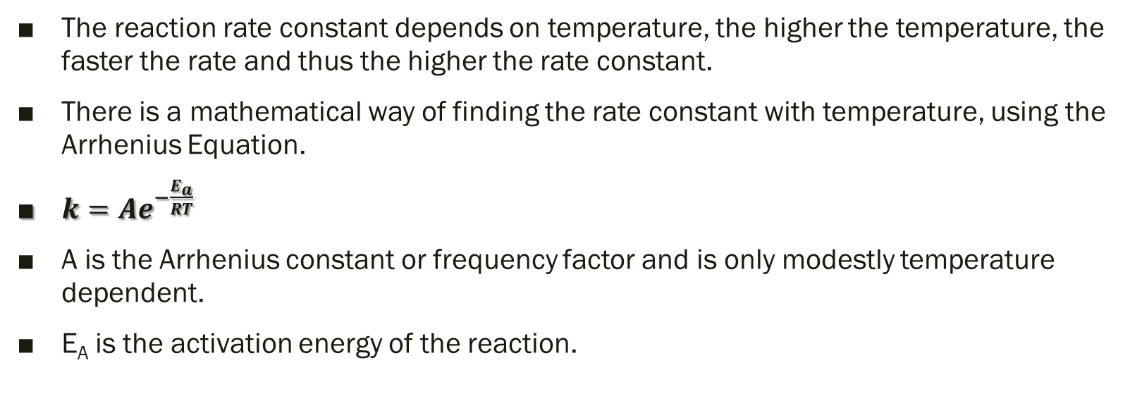
Arrhenius Equation
The reaction rate constant depends on temperature, the higher the temperature, the faster the rate and thus the higher the rate constant.
There is a mathematical way of finding the rate constant with temperature, using the Arrhenius Equation.
$k=Ae^{−\frac{E_{a}}{RT}}$
A is the Arrhenius constant or frequency factor and is only modestly temperature dependent.
E_{A} is the activation energy of the reaction.

Slide 18
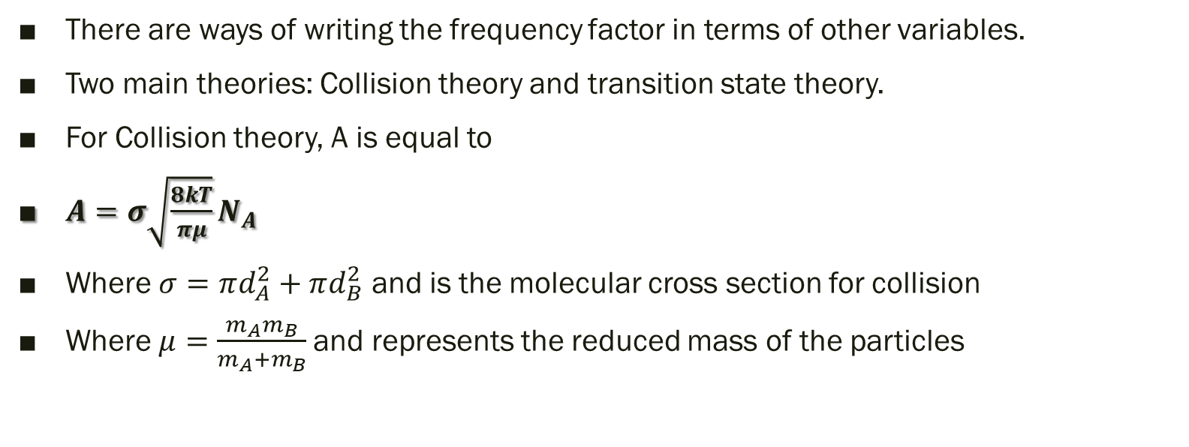
The Frequency Factor’s Dependence on Temperature
There are ways of writing the frequency factor in terms of other variables.
Two main theories: Collision theory and transition state theory.
For Collision theory, A is equal to
$A=σ\sqrt{\frac{8kT}{πμ}}N_{A}$
Where $σ=πd_{A}^{2}+πd_{B}^{2}$ and is the molecular cross section for collision
Where $μ=\frac{m_{A}m_{B}}{m_{A}+m_{B}}$and represents the reduced mass of the particles

Slide 19
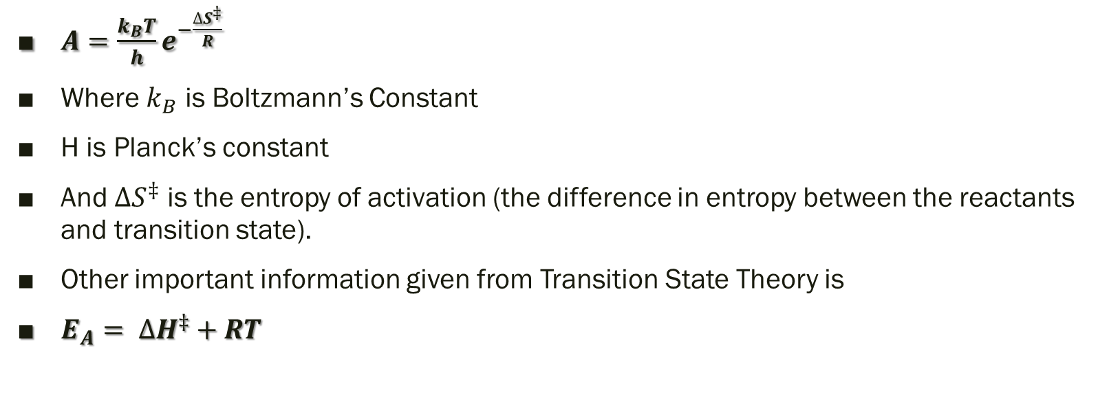
Transition State Theory
$A=\frac{k_{B}T}{h}e^{−\frac{∆S^{‡}}{R}}$
Where $k_{B}$ is Boltzmann’s Constant
H is Planck’s constant
And $∆S^{‡}$ is the entropy of activation (the difference in entropy between the reactants and transition state).
Other important information given from Transition State Theory is
$E_{A}= ∆H^{‡}+RT$

