Slide 1
Foundations of Physical Chemistry Chapter 4: Physical Transformations
NeighborhoodGeeks

Slide 2
What Causes a Phase Change?
When the Molar Gibbs Free Energy, Gm of one phase is less than the Gm of another, a phase transition will spontaneously occur.
Remember, nature always likes to go towards an energy minimum wherever that is to be found!
A phase transition occurs when the Gm of one phase is equal to the Gm of another, this is an equilibrium process.
When ΔG = 0, the system is always at equilibrium!

Slide 3
Introducing The VATVUS Diagram!
Firstly, what is the VATVUS diagram?
It is also called the Thermodynamic Square and it is useful for getting thermodynamic relationships such as Maxwell Relations.
It is one of the most useful diagrams in all of physical chemistry!
This is what it looks like:

Slide 4
You’re Not Amazed??
The utility in the VATVUS diagram isn’t obvious, however, here is how you use it:
Select one of the following variables (G, A, U, and H)
If you want to find the total differential for each of those variables look at the variables directly above or below or to the left and right of the variable.
Now go down one of the arrows, if going in the direction of the arrow, this term is positive, if going against the arrow, this term is negative
Let’s do an example with our pal G

Slide 5
How to Use the VATVUS Diagram
Directly above G is T and directly below G is P therefore we have this as our preliminary equation
$dG=[]dT±[]dP$
If we go up to T, we must go down to S, this goes against the arrow’s direction and therefore this term is negative so this variable S is negative in the equation
$dG=−SdT±[]dP$
If we go down to P, we must go up to V, this goes with the arrow and therefore this term is positive so this variable V is positive in the equation
$dG=−SdT+VdP$

Slide 6
This is Great and All But Why Do We Care?
Remember ΔG predicts spontaneity, therefore, at a phase transition, the dG of both phases will be the exact same. We can use this information to get use an expression for vapor pressure and temperature for evaporation.
$dG_{phase1}=dG_{phase2}$
$−S_{phase1}dT+V_{phase1}dP=−S_{phase2}dT+V_{phase2}dP$
$\left(−S_{phase1}+S_{phase2}\right)dT={(V}_{phase2}−V_{phase1})dP$
$\left(S_{phase2}−S_{phase1}\right)dT=\left(V_{phase2}−V_{phase1}\right)dP$
$∆S_{transition}dT= ∆V_{transition}dP$
$\frac{dP}{dT}=\frac{∆S_{transition}}{∆V_{transition}}$

Slide 7
What Does this Differential Equation Mean?
This term, $\frac{dP}{dT}$ says how pressure changes with temperature when a substance is undergoing a phase transition. In other words, we can determine the pressure necessary to make a phase change occur if we know the spontaneous temperature (e.g. boiling point at SATP)
But wait, we know that during a transition,
$∆S_{transition}=\frac{∆H_{transition}}{T}$
Therefore…
$\frac{dP}{dT}=\frac{∆H_{transition}}{T∆V_{transition}}$

Slide 8
Let’s Apply This to the Process of Evaporation
If a liquid is going to the gas phase, there is a massive volume change
Let’s take water for example, at room temperature, one mole of water weighs 18 grams and is 18 mL, when it vaporizes to the gas phase at SATP, it now goes to approximately 22.4 L, that’s over 1000x larger!
Therefore, the change in volume in the process of evaporation we can ignore the volume of the liquid phase… the volume change is essentially just the volume of the gas generated.

Slide 9
Application of VATVUS Diagram Cont.
$\frac{dP}{dT}=\frac{∆H_{vap}}{TV_{gas}}$
Now let us assume the gas at this temperature behaves sufficiently like an ideal gas…
$PV=nRT$
$V=\frac{nRT}{P}$
$\frac{dP}{dT}=\frac{P ∆H_{vap}}{nRT^{2}}$
$\frac{dP}{P}=\frac{∆H_{vap}}{RT^{2}}dT$

Slide 10
Solving the Differential Equation
$\frac{dP}{P}=\frac{∆H_{vap}}{RT^{2}}dT$
$\int_{P_{1}}^{P_{2}}{\frac{1}{P}dP}=\int_{T_{1}}^{T_{2}}{\frac{∆H_{vap}}{RT^{2}}dT}$
The enthalpy of vaporization is usually not strongly dependent upon T, therefore it is a constant
$\ln\left(\frac{P_{2}}{P_{1}}\right)=\frac{∆H_{vap}}{R}\left(−\frac{1}{T_{2}}+\frac{1}{T_{1}}\right)$
$\ln\left(\frac{P_{2}}{P_{1}}\right)=\frac{∆H_{vap}}{R}\left(\frac{1}{T_{1}}−\frac{1}{T_{2}}\right)$ or
$ln\left(\frac{P_{2}}{P_{1}}\right)=−\frac{∆H_{vap}}{R}\left(\frac{1}{T_{2}}−\frac{1}{T_{1}}\right)$

Slide 11
We Just Derived the Clausius Clapeyron Equation!
This is an incredibly powerful equation because it can predict the boiling point at different temperatures… that is the power of the VATVUS diagram.

Slide 12
What Else Can the VATVUS Diagram Do?
It can tell you how different thermodynamic quantities change with other quantities.
For example:
${\left(\frac{∂G}{∂T}\right)}_{V}=−S$
${\left(\frac{∂G}{∂P}\right)}_{T}=V$
It can also tell you Maxwell Relations…

Slide 13
Maxwell Relations
Recall the VATVUS Diagram:
To get Maxwell Relations, draw two parallel lines such that the endpoints of the two parallel lines are the things you want to find the partial derivatives with respect to and set these two partial derivatives equal to each other.

Slide 14
Maxwell Relations Cont.
The variable that are kept constant in each side of the equation is the one that is diagonally opposite to the starting point of each line you drew.
Whenever S and P are located on the same side of the equation, put a negative sign (yes that includes when S or P is being kept constant on that side)

Slide 15
Maxwell Relation Example:
Let’s do the relationship between T and V and P and S
Recall what the VATVUS diagram looks like:
${\left(\frac{∂T}{∂V}\right)}_{S}={\left(\frac{∂P}{∂S}\right)}_{V}$
Because S and P occur on the RHS, there must be a negative
${\left(\frac{∂T}{∂V}\right)}_{S}={−\left(\frac{∂P}{∂S}\right)}_{V}$

Slide 16
Why Do We Care About Maxwell Relations?
Well aside from being super cool, they help us relate changes in thermodynamic quantities that are hard to keep constant with ones t that are easy to make constant.
It is extremely difficult (might I say impossible) to keep entropy, S, constant, but it is very easy to keep volume, V, constant for example.

Slide 17
List of Maxwell Relations
${\left(\frac{∂T}{∂V}\right)}_{S}=−{\left(\frac{∂P}{∂S}\right)}_{V}$
${\left(\frac{∂P}{∂T}\right)}_{V}={\left(\frac{∂S}{∂V}\right)}_{T}$
${\left(\frac{∂V}{∂S}\right)}_{P}={\left(\frac{∂T}{∂P}\right)}_{S}$
${\left(\frac{∂V}{∂T}\right)}_{P}={−\left(\frac{∂S}{∂P}\right)}_{T}$

Slide 18
Variation of Gibbs Energy (Pressure)
Recall that $dG=−SdT+VdP$
Therefore at constant T
$dG=VdP$
To find the change in free energy, therefore,
$\int_{G_{i}}^{G_{f}}{dG}= \int_{P_{i}}^{P_{f}}{VdP}$
If the volume of the substance does not change (e.g. it is a solid or liquid which are incompressible) then V is constant and can be taken out of the integrand
$∆G=V∆P$ (For solids and incompressible liquids)

Slide 19
Variation of Gibbs Energy (Pressure) Cont.
If the substance is in the gas phase and we assume that it is an ideal gas then V is not independent of P and therefore
$\int_{G_{i}}^{G_{f}}{dG}= \int_{P_{i}}^{P_{f}}{VdP}$
$PV=nRT$
$V=\frac{nRT}{P}$
$∆G=nRT \int_{P_{i}}^{P_{f}}{\frac{1}{P}dP}$
$∆G=nRT\ln\left(\frac{P_{f}}{P_{i}}\right)$ for an ideal gas

Slide 20
Variation of Gibbs Energy (Temperature)
Recall that from the VATVUS diagram,
$dG=−SdT+VdP$
If the system is at constant pressure then
$dG=−SdT$
$\int_{G_{i}}^{G_{f}}{dG}= \int_{T_{i}}^{T_{f}}{−SdT}$
$∆G=−S∆T$

Slide 21
Gibbs-Helmholtz Equation
The following equation is one of the most important equations in all of physical chemistry because it lays the foundation of equilibrium as we will see later on…
$\frac{d\left(\frac{G}{T}\right)}{dT}=−\frac{H}{T^{2}}$

Slide 22
Phase Diagrams
Show which phase is the dominant phase at a given temperature and pressure.
There are two special points on the phase diagram, the triple point and the critical point
At the triple point, all three phases are in equilibrium with each other
At the critical point, the liquid and gas phases become indistinguishable

Slide 23
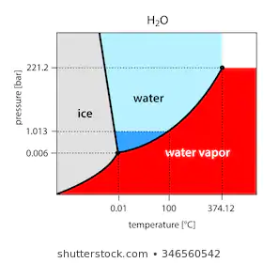
Degrees of Freedom, F
The Gibbs phase rule is as follows:
$F=C+2−P$
Where F is the degrees of freedom
C is the number of components in the mixture
And P is the number of phases present
Tells you the number of variables (P or T) that can be changed without undergoing a phase change

Slide 24
Introducing Mixtures:
Thus far we have only discussed the physical changes that pure matter can undergo.
Now we will see about the thermodynamics of mixtures…

Slide 25
Partial Molar Volume
When two liquids mix together, oftentimes their volumes are not additive, if you add 15 mL of absolute ethanol to 15 mL of pure water the total volume will not be 30 mL exactly, it will likely be less.
This is because the intermolecular forces among water molecules are different than those between ethanol and water.
This necessitates us to define something called the partial molar volume or $\tilde{V}$
For a mixture of two substances, A and B, the total volume of the mixture is given by
$V=n_{A}{\tilde{V}}_{A}+n_{B}{\tilde{V}}_{B}$

Slide 26
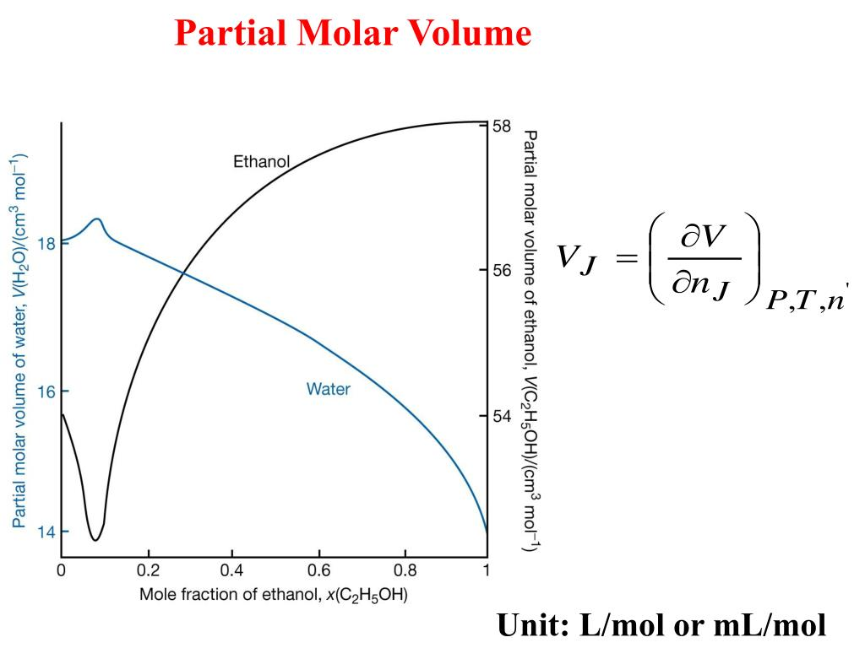
Partial Molar Volume Plots
One can plot the partial molar volume of either component of the mixture against the mole fraction of one of the components.
An example of this is shown below:

Slide 27
Chemical Potential
When two substances are mixed together, their Gibbs free energy is referred to as their Chemical Potential, μ
Therefore the total Gibbs energy of a mixture is given by:
$G=n_{A}μ_{A}+n_{B}μ_{B}$
Therefore if the pressure were to change, the new chemical potential would be
$μ_{A}= μ_{A}^{0}+RTln\left(\frac{P_{A}}{P_{0}}\right)$

Slide 28
Chemical Potential Cont.
If the partial pressure of component, A changes from $P_{A_{i}}$ to $P_{A_{f}}$
The chemical potential changes by
$∆μ_{A}= μ_{f} −μ_{i}$
$∆μ_{A}= μ_{A}^{0}+RTln\left(\frac{P_{Af}}{P_{0}}\right)−\left(μ_{A}^{0}+RTln\left(\frac{P_{A_{i}}}{P_{0}}\right)\right)$
$∆μ_{A}=RTln\left(\frac{P_{A_{f}}}{P_{0}}\right)−RTln\left(\frac{P_{A_{i}}}{P_{0}}\right)$
$∆μ_{A}=RT\left(\ln\left(P_{A_{f}}\right)−\ln\left(P_{A_{i}}\right)\right)$
$∆μ_{A}=RTln\left(\frac{P_{A_{f}}}{P_{A_{i}}}\right)$

Slide 29
Gibbs Energy of Mixing
Are mixing to gases together spontaneous?
Yes, exactly it is, you don’t need to provide energy to make two gases mix together. Therefore, the Gibbs Energy of mixing ought to be negative
The $∆G_{mixing}=nRT\left(χ_{A}\ln\left(χ_{A}\right)+χ_{B}\ln\left(χ_{B}\right) \right)$ for ideal gases
Where χ represents the mole fraction of each component.
Because nRT is strictly positive and the logarithmic terms are strictly negative, the Gibbs Energy of Mixing is always negative

Slide 30
Enthalpy and Entropy of Mixing
When two gases mix together, there is no heat provided and therefore there is no enthalpy of mixing,
$∆H_{mixing}=0J$
If this is true, we can determine an expression for the Entropy of mixing
$∆G_{mixing}= ∆H_{mixing}−T∆S_{mixing}$
$∆G_{mixing}=−T∆S_{mixing}$
$∆S_{mixing}=−nR\left(χ_{A}\ln\left(χ_{A}\right)+χ_{B}\ln\left(χ_{B}\right) \right)$

Slide 31
Raoult’s law
When two components make a solution, there are two things, solvent and solute
The vapor pressure of a pure substance will be decreased in solution as a function of its mole fraction. This behavior is described by Raoult’s law
$P_{A}= χ_{A}P_{A}^{∗}$
Where $P_{A}^{∗}$ represents the pure vapor pressure of component A not in solution.
An ideal solution is one that obeys Raoult’s law at all compositions
Works best for the solvent (the component in excess)

Slide 32
Chemical Potential of Solvent
The Gibbs energy of both solvent and solute decreases when in solution, the chemical potential of the solvent is given by
$μ_{A}= μ_{A}^{∗}+RTln\left(χ_{A}\right)$
Where $μ_{A}^{∗}$ is the chemical potential of pure A
The Gibbs energy and Entropy of dissolving is the exact same expression as the mixing formulae

Slide 33
Ideal-Dilute Solutions
Just as Raoult’s Law is followed best for the solvent, Henry’s Law is followed best for the solute.
Henry’s Law takes two forms:
$P_{B}=K_{H}^{′}χ_{B}$
$c_{B}=K_{H}P_{B}$
The chemical potential of the solute has the same form as the chemical potential of the solvent:
$μ_{B}= μ_{B}^{∗}+RTln\left(χ_{B}\right)$ or
$μ_{B}= μ_{B}^{0}+RTln\left(c_{B}\right)$

Slide 34
Colligative Properties
When solutes are dissolved in solution, the pure solvent loses some chemical potential, therefore, it will be resistant to change to another phase.
Recall that a system will only change phases insofar as the Gibbs energy of that phase is lower, since we are lowering the Gibbs energy of the solution by adding solute, it will be harder for it to solidify or vaporize.
This phenomena is called Freezing Point Depression and Boiling Point Elevation
These phenomena can be related to two constants, the ebullioscopic constant and the cryoscopic constant

Slide 35
Freezing Point Depression and Boiling Point Elevation
Both of these equations share the same form
$∆T_{b}=K_{b}b_{B}$
$∆T_{f}=K_{f}b_{B}$
Where b is the molality of solute, B
Molality is the moles of solute per kg of solvent

Slide 36
Osmotic Pressure
So this is an interesting one, because you already know this without realizing you do because it bares an close resemblance to what you know from General Chemistry I.
The osmotic pressure, Π, is given by
$ΠV=nRT$
For an ideal solution
$Π=c_{B}RT$
Because the moles divided by volume is the concentration

Slide 37
Uses of Osmotic Pressure
Osmotic Pressure can be used to determine the molecular weight of an unknown.
The osmotic pressure can be expressed as a Taylor series in concentration of solute,
$Π=c_{b}RT\left(1+B_{cb}+ …\right)$
Like the last time we saw the Virial Equation, we could truncate it after the B term
Therefore…
$\frac{Π}{c_{b}}=RT+BRTc_{b}$
Y = b + mx

Slide 38
Phase Diagrams of Mixtures
One can look at the phases of mixtures and vary the mole fraction of one component.
These will produce phase diagrams of the mixture from which one can employ techniques to find the exact composition.
Introducing the Lever Rule:
$\frac{n_{A}}{n_{B}}=\frac{l_{B}}{l_{A}}$
Where l represents the length of the line from the center to the one phase (A or B).

Slide 39
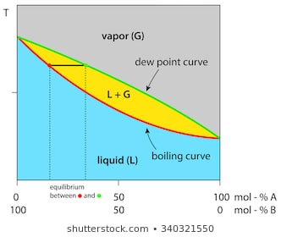

Slide 40
Nernst Distribution Law
Suppose you’re doing a solvent extraction with diethyl ether and water trying to extract an analyte of interest.
These two liquids are immiscible; they will form two distinct layers (specifically the ether layer will be on top and the water on the bottom)
There will almost always be some component of the analyte in both layers, this relationship is given by the Nernst Distribution Law
$\frac{χ_{c}\left(2\right)}{χ_{c}\left(1\right)}=constant$
The quotient of the mole fractions in either layer will always be a constant

