Slide 1
Foundations of Physical Chemistry:
Chapter 3: Second and Third Laws of Thermodynamics
NeighborhoodGeeks

Slide 2
What is the Second Law of Thermodynamics
The second law introduces the concept of Entropy, S
Entropy is the concept of disorder within a system, the more disordered the system becomes the more favorable it is.
It is inherently more spontaneous for a system to become more disordered (think about your desk at home, I know mine is a mess)

Slide 3
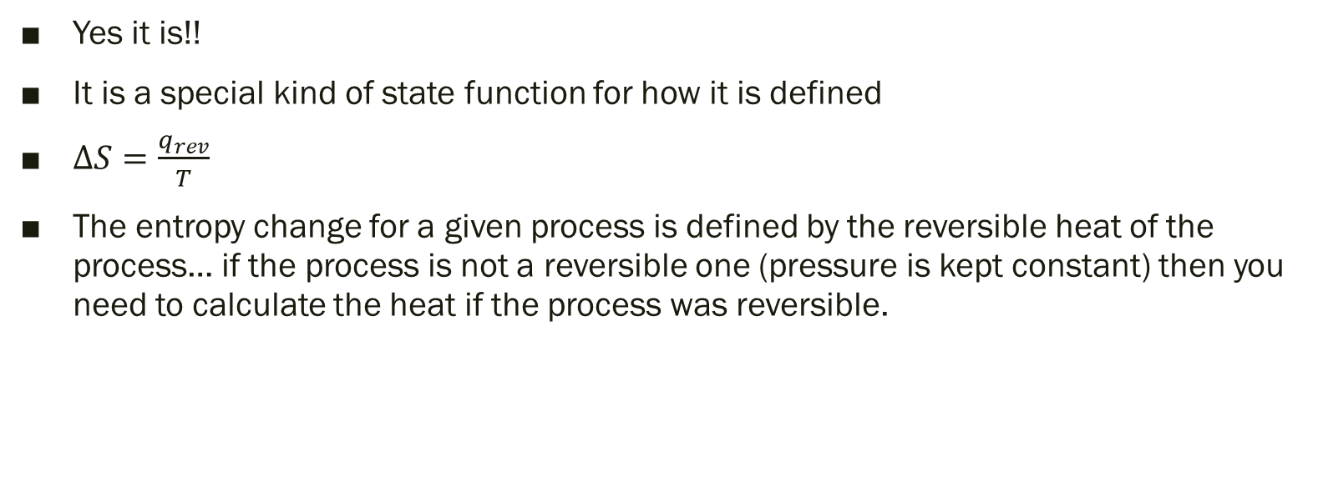
Is Entropy a State Function?
Yes it is!!
It is a special kind of state function for how it is defined
$∆S=\frac{q_{rev}}{T}$
The entropy change for a given process is defined by the reversible heat of the process… if the process is not a reversible one (pressure is kept constant) then you need to calculate the heat if the process was reversible.

Slide 4
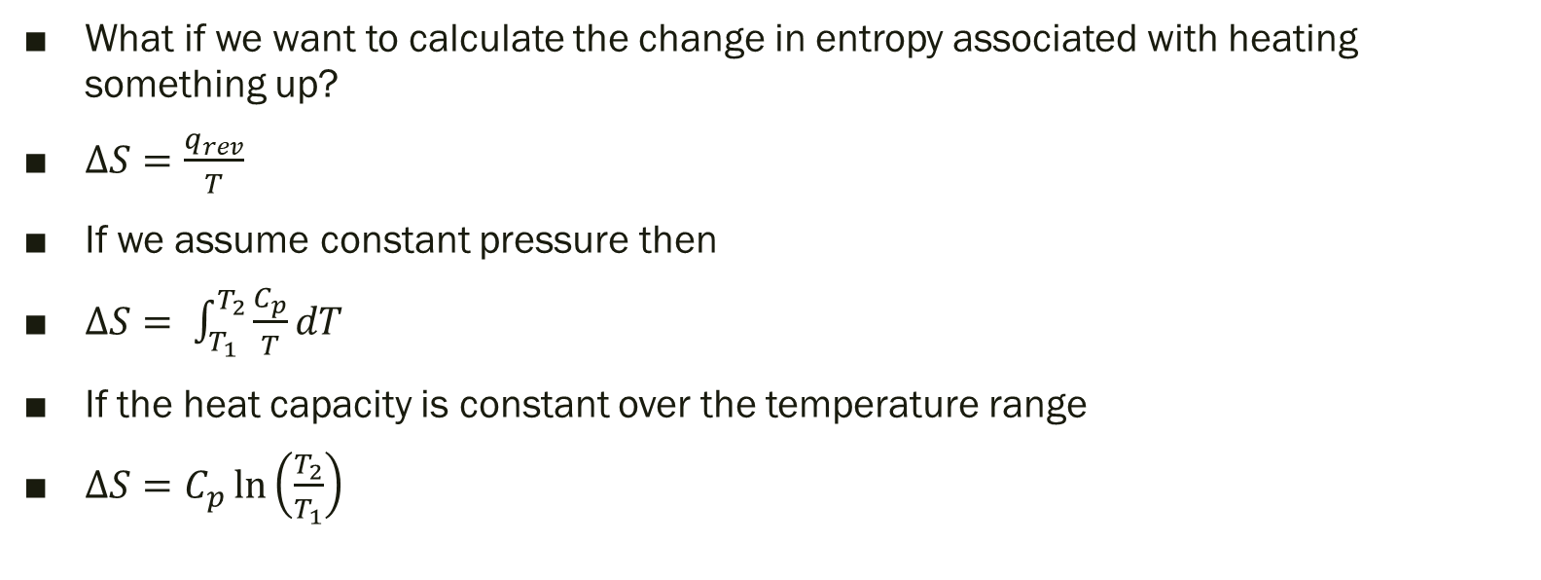
How to calculate changes in entropy (Temperatures)
What if we want to calculate the change in entropy associated with heating something up?
$∆S=\frac{q_{rev}}{T}$
If we assume constant pressure then
$∆S= \int_{T_{1}}^{T_{2}}{\frac{C_{p}}{T}dT}$
If the heat capacity is constant over the temperature range
$∆S=C_{p}\ln\left(\frac{T_{2}}{T_{1}}\right)$

Slide 5
How to calculate changes in entropy (Temperatures) Cont.
Does this result make sense?
If the substance is being heated up then the molecules are moving around faster and being more disorderly, therefore the change should be positive.
Ln(2/1) > 0 therefore the change in entropy is positive because heat capacities are strictly positive.

Slide 6
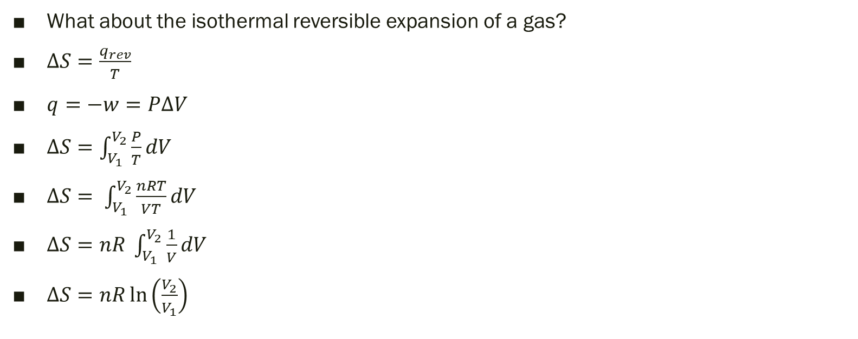
How to calculate changes in entropy (volumes)
What about the isothermal reversible expansion of a gas?
$∆S=\frac{q_{rev}}{T}$
$q=−w=P∆V$
$∆S=\int_{V_{1}}^{V_{2}}{\frac{P}{T}dV}$
$∆S= \int_{V_{1}}^{V_{2}}{\frac{nRT}{VT}}dV$
$∆S=nR \int_{V_{1}}^{V_{2}}{\frac{1}{V}dV}$
$∆S=nR\ln\left(\frac{V_{2}}{V_{1}}\right)$

Slide 7
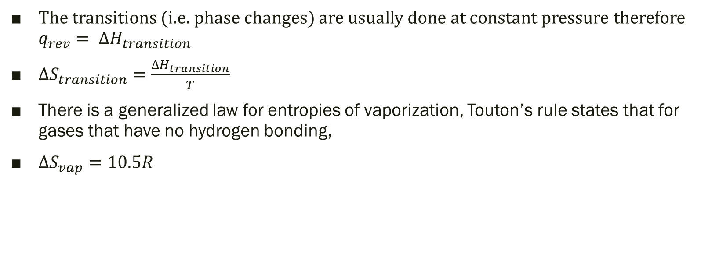
How to calculate changes in entropy (transitions)
The transitions (i.e. phase changes) are usually done at constant pressure therefore $q_{rev}= ∆H_{transition}$
$∆S_{transition}=\frac{∆H_{transition}}{T}$
There is a generalized law for entropies of vaporization, Touton’s rule states that for gases that have no hydrogen bonding,
$∆S_{vap}=10.5R$

Slide 8

Efficiency of a heat engine
The thermodynamic efficiency of a heat engine is given by eta and is
$η=1−\frac{T_{cold}}{T_{hot}}$

Slide 9
What is the Third Law of Thermodynamics
The third law of thermodynamics introduces the concept of absolute entropy.
It states that the absolute entropy for a perfectly crystalline solid at absolute 0 is 0 J/molK
For most everything, they are not perfectly crystalline solids at absolute zero so…

Slide 10
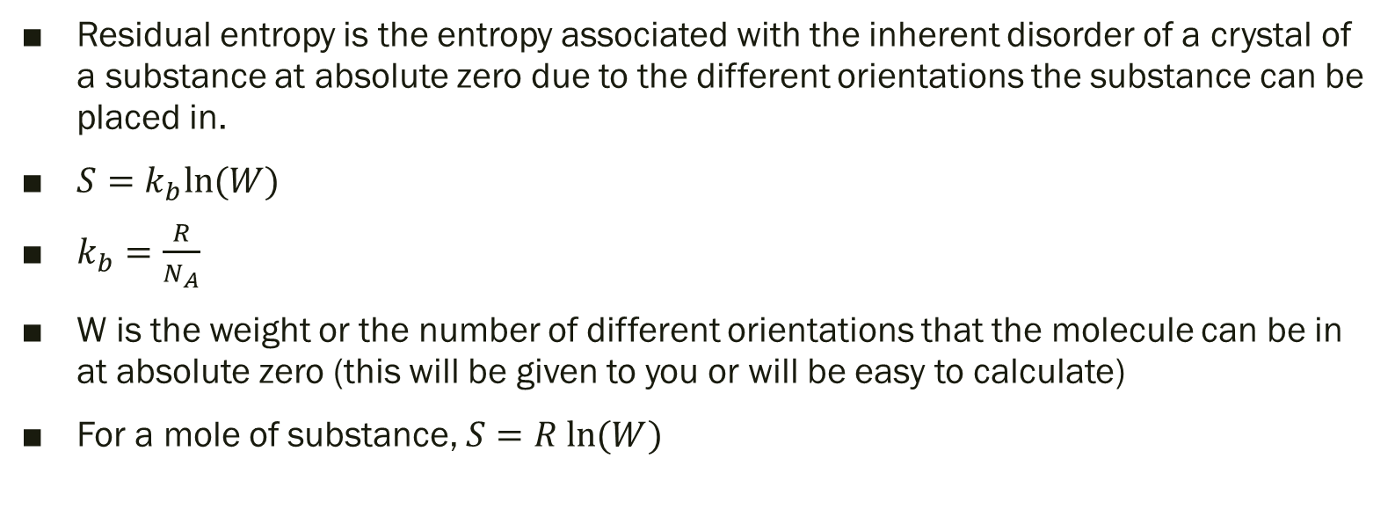
Residual Entropy
Residual entropy is the entropy associated with the inherent disorder of a crystal of a substance at absolute zero due to the different orientations the substance can be placed in.
$S=k_{b}ln⁡(W)$
$k_{b}=\frac{R}{N_{A}}$
W is the weight or the number of different orientations that the molecule can be in at absolute zero (this will be given to you or will be easy to calculate)
For a mole of substance, $S=R ln⁡(W)$

Slide 11
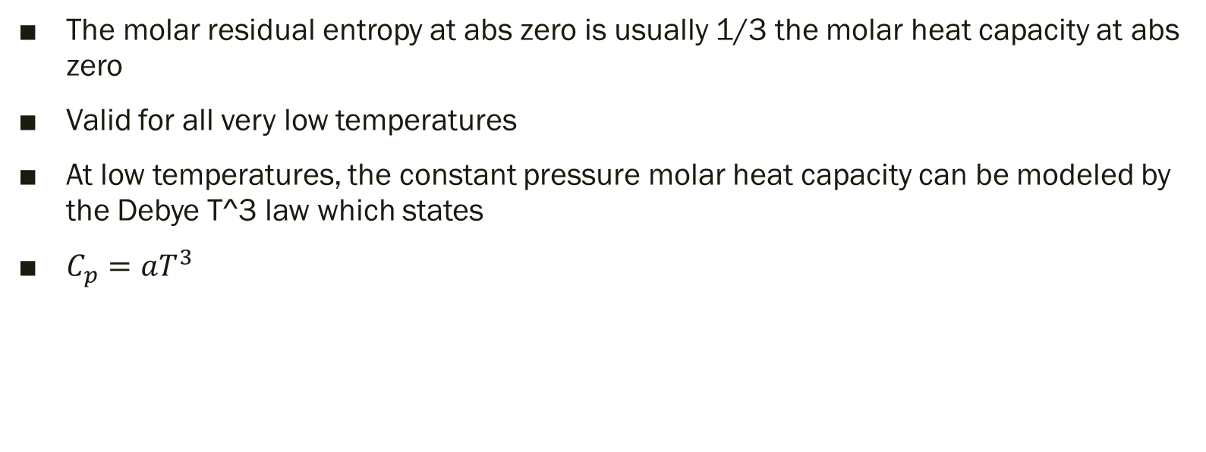
Estimating the molar residual entropy at abs zero
The molar residual entropy at abs zero is usually 1/3 the molar heat capacity at abs zero
Valid for all very low temperatures
At low temperatures, the constant pressure molar heat capacity can be modeled by the Debye T^3 law which states
$C_{p}=aT^{3}$

Slide 12
What is Gibb’s Free Energy
Gibb’s Free Energy is the energy available to do non-expansion work
It represents the spontaneity of the reaction, negative G means spontaneous, positive G means nonspontaneous.
Spontaneity means nothing about RATE, something can be thermodynamically favorable (spontaneous) but be extremely slow to occur (such as the conversion of diamond to graphite).

Slide 13

Equation for Gibb’s Energy
$∆G= ∆H−T∆S_{sys}= −T∆S_{total}=w_{nonexpansion max}$

