Slide 1
Foundations of Physical Chemistry:
Chapter 2: First Law of Thermodynamics
NeighborhoodGeeks

Slide 2
What Is Thermodynamics?
Thermodynamics is the study of heat, work, and other fundamental functions of nature relating to physical processes.
There are several quantities in thermodynamics with which you should be familiar: q, heat; w, work; U, internal energy; H, enthalpy; S, entropy; G, Gibbs free energy; A, Helmholtz free energy.
Some of these quantities are known as state functions

Slide 3
What is a state function?
A state function is a variable whose value depends solely on the initial and final states. It is path-independent.
As we will soon discuss, only very few things are state functions, but the ones that are just so happen to be the most important ones for our analysis of Chemistry.
Here are a list of some state functions: U, H, S, G, A

Slide 4
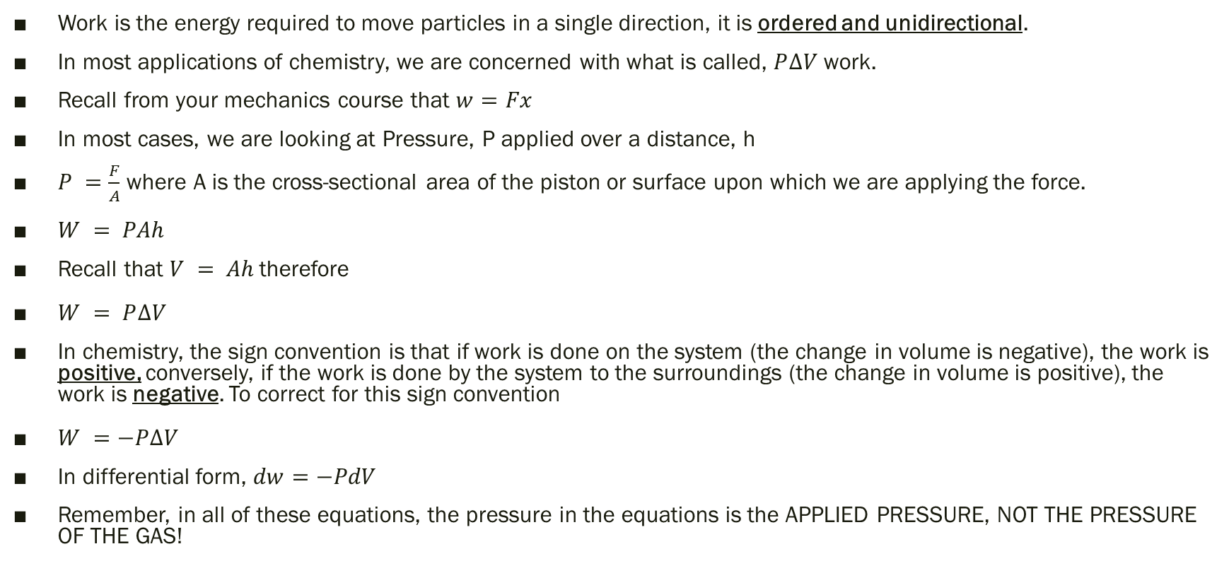
What is Work?
Work is the energy required to move particles in a single direction, it is ordered and unidirectional.
In most applications of chemistry, we are concerned with what is called, $P∆V$ work.
Recall from your mechanics course that $w=Fx$
In most cases, we are looking at Pressure, P applied over a distance, h
$P =\frac{F}{A}$ where A is the cross-sectional area of the piston or surface upon which we are applying the force.
$W = PAh$
Recall that $V = Ah$therefore
$W = P∆V$
In chemistry, the sign convention is that if work is done on the system (the change in volume is negative), the work is positive, conversely, if the work is done by the system to the surroundings (the change in volume is positive), the work is negative. To correct for this sign convention
$W =−P∆V$
In differential form, $dw=−PdV$
Remember, in all of these equations, the pressure in the equations is the APPLIED PRESSURE, NOT THE PRESSURE OF THE GAS!

Slide 5
What is with the differentials?
A frequent question that is asked by students (and admittedly myself at some stage) is why put the differential equation up?
The reason why the differential form is useful is that not all pressures that are applied are constant, they could change depending upon how hard your pressing over time. If the pressure is NOT constant in your process, you MUST use the differential form!!

Slide 6
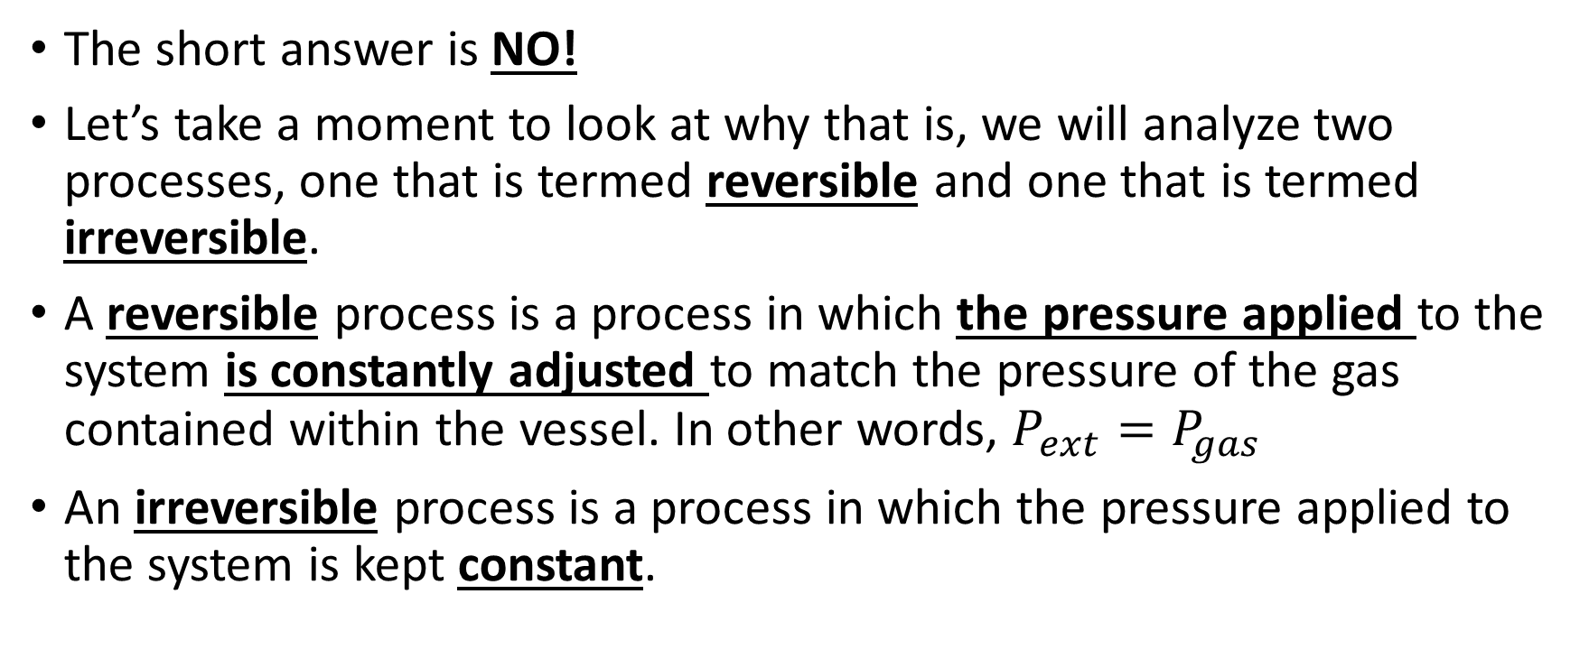
Is work a state function?
The short answer is NO!
Let’s take a moment to look at why that is, we will analyze two processes, one that is termed reversible and one that is termed irreversible.
A reversible process is a process in which the pressure applied to the system is constantly adjusted to match the pressure of the gas contained within the vessel. In other words, $P_{ext}=P_{gas}$
An irreversible process is a process in which the pressure applied to the system is kept constant.

Slide 7
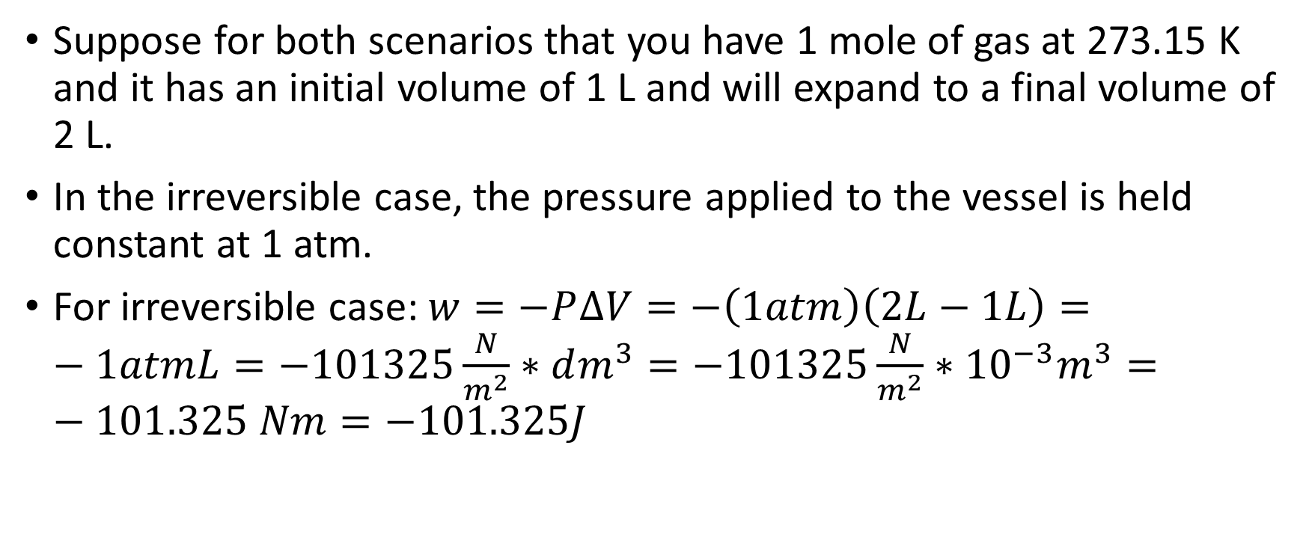
This is why work is not a state function:
Suppose for both scenarios that you have 1 mole of gas at 273.15 K and it has an initial volume of 1 L and will expand to a final volume of 2 L.
In the irreversible case, the pressure applied to the vessel is held constant at 1 atm.
For irreversible case: $w=−P∆V=−\left(1atm\right)\left(2L−1L\right)=−1atmL=−101325\frac{N}{m^{2}}∗dm^{3}=−101325\frac{N}{m^{2}}∗{10}^{−3}m^{3}=−101.325 Nm=−101.325J$

Slide 8
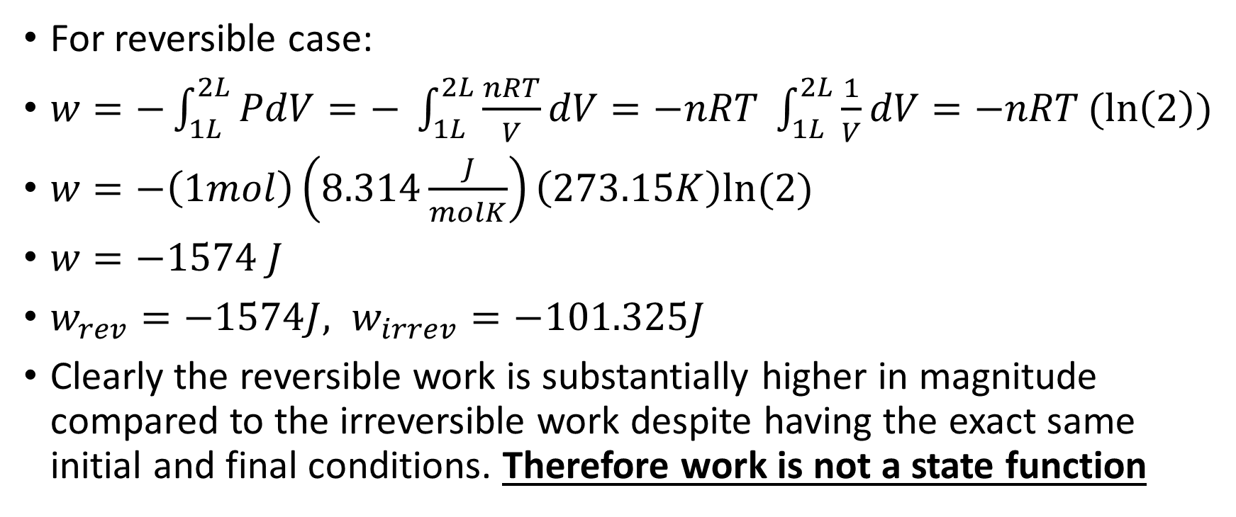
This is why work is not a state function:
For reversible case:
$w=−\int_{1L}^{2L}{PdV=− \int_{1L}^{2L}{\frac{nRT}{V}dV=−nRT \int_{1L}^{2L}{\frac{1}{V}dV=−nRT(ln\left(2\right))}}}$
$w=−\left(1mol\right)\left(8.314\frac{J}{molK}\right)\left(273.15K\right)ln⁡(2)$
$w=−1574 J$
$w_{rev}=−1574J, w_{irrev}=−101.325J$
Clearly the reversible work is substantially higher in magnitude compared to the irreversible work despite having the exact same initial and final conditions. Therefore work is not a state function

Slide 9
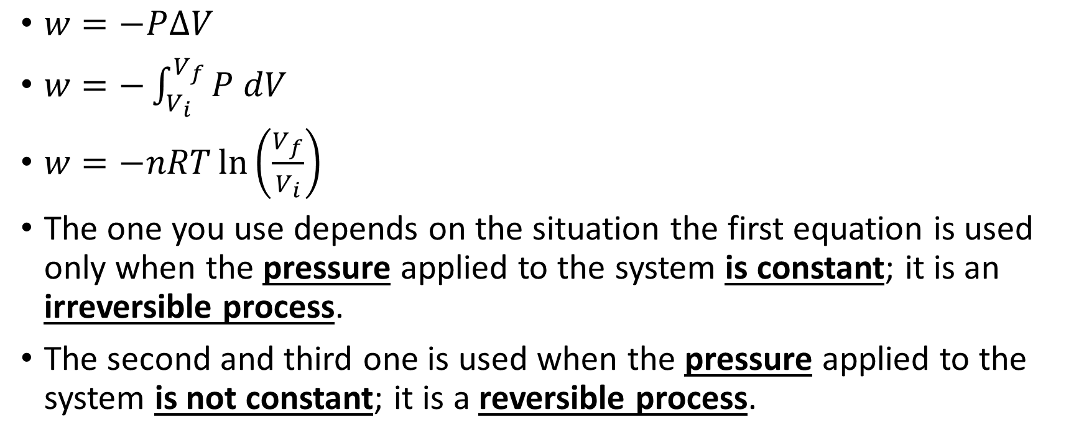
Formulas for work
$w=−P∆V$
$w=−\int_{V_{i}}^{V_{f}}{P dV}$
$w=−nRT\ln\left(\frac{V_{f}}{V_{i}}\right)$
The one you use depends on the situation the first equation is used only when the pressure applied to the system is constant; it is an irreversible process.
The second and third one is used when the pressure applied to the system is not constant; it is a reversible process.

Slide 10
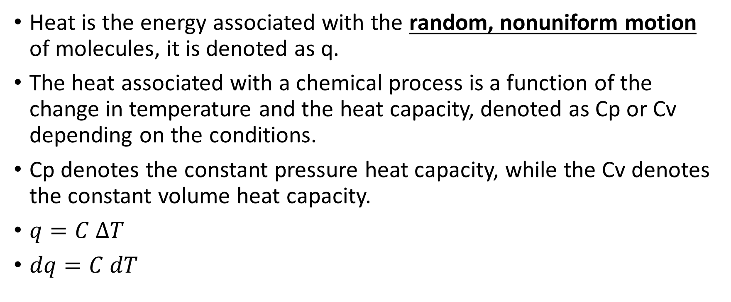
What is heat?
Heat is the energy associated with the random, nonuniform motion of molecules, it is denoted as q.
The heat associated with a chemical process is a function of the change in temperature and the heat capacity, denoted as Cp or Cv depending on the conditions.
Cp denotes the constant pressure heat capacity, while the Cv denotes the constant volume heat capacity.
$q=C ∆T$
$dq=C dT$

Slide 11
Is Heat a state function?
Heat is NOT a state function and it depends upon path and environmental conditions (constant pressure versus constant volume processes).
If the heat capacity is not constant over the temperatures you are studying (this is not usually the case unless you are at extremely low temperatures), then you must use the differential form of the heat equation.
If the heat capacity is constant over the temperature range that you are interested in, you can use the algebraic verison.

Slide 12
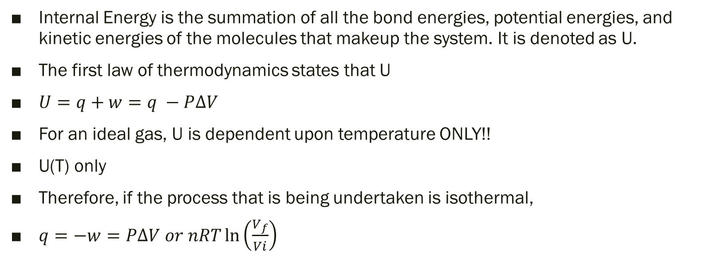
What is Internal Energy?
Internal Energy is the summation of all the bond energies, potential energies, and kinetic energies of the molecules that makeup the system. It is denoted as U.
The first law of thermodynamics states that U
$U=q+w=q −P∆V$
For an ideal gas, U is dependent upon temperature ONLY!!
U(T) only
Therefore, if the process that is being undertaken is isothermal,
$q=−w=P∆V or nRT\ln\left(\frac{V_{f}}{Vi}\right)$

Slide 13
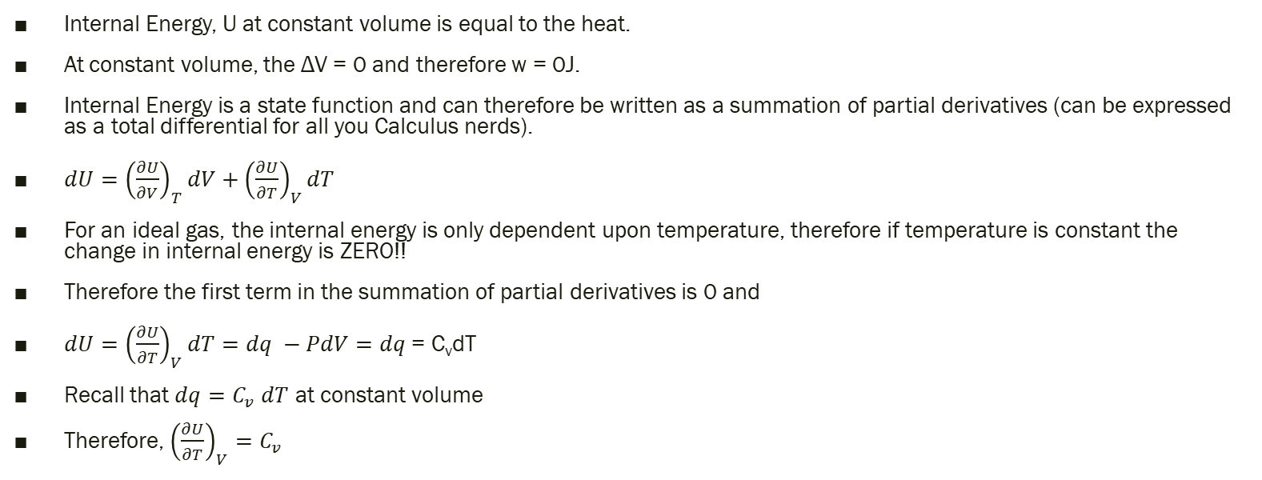
What is Internal Energy Cont.
Internal Energy, U at constant volume is equal to the heat.
At constant volume, the ΔV = 0 and therefore w = 0J.
Internal Energy is a state function and can therefore be written as a summation of partial derivatives (can be expressed as a total differential for all you Calculus nerds).
$dU={\left(\frac{∂U}{∂V}\right)}_{T}dV+{\left(\frac{∂U}{∂T}\right)}_{V}dT$
For an ideal gas, the internal energy is only dependent upon temperature, therefore if temperature is constant the change in internal energy is ZERO!!
Therefore the first term in the summation of partial derivatives is 0 and
$dU={\left(\frac{∂U}{∂T}\right)}_{V}dT=dq −PdV=dq$ = C_{v}dT
Recall that $dq=C_{v} dT$ at constant volume
Therefore, ${\left(\frac{∂U}{∂T}\right)}_{V}=C_{v}$

Slide 14
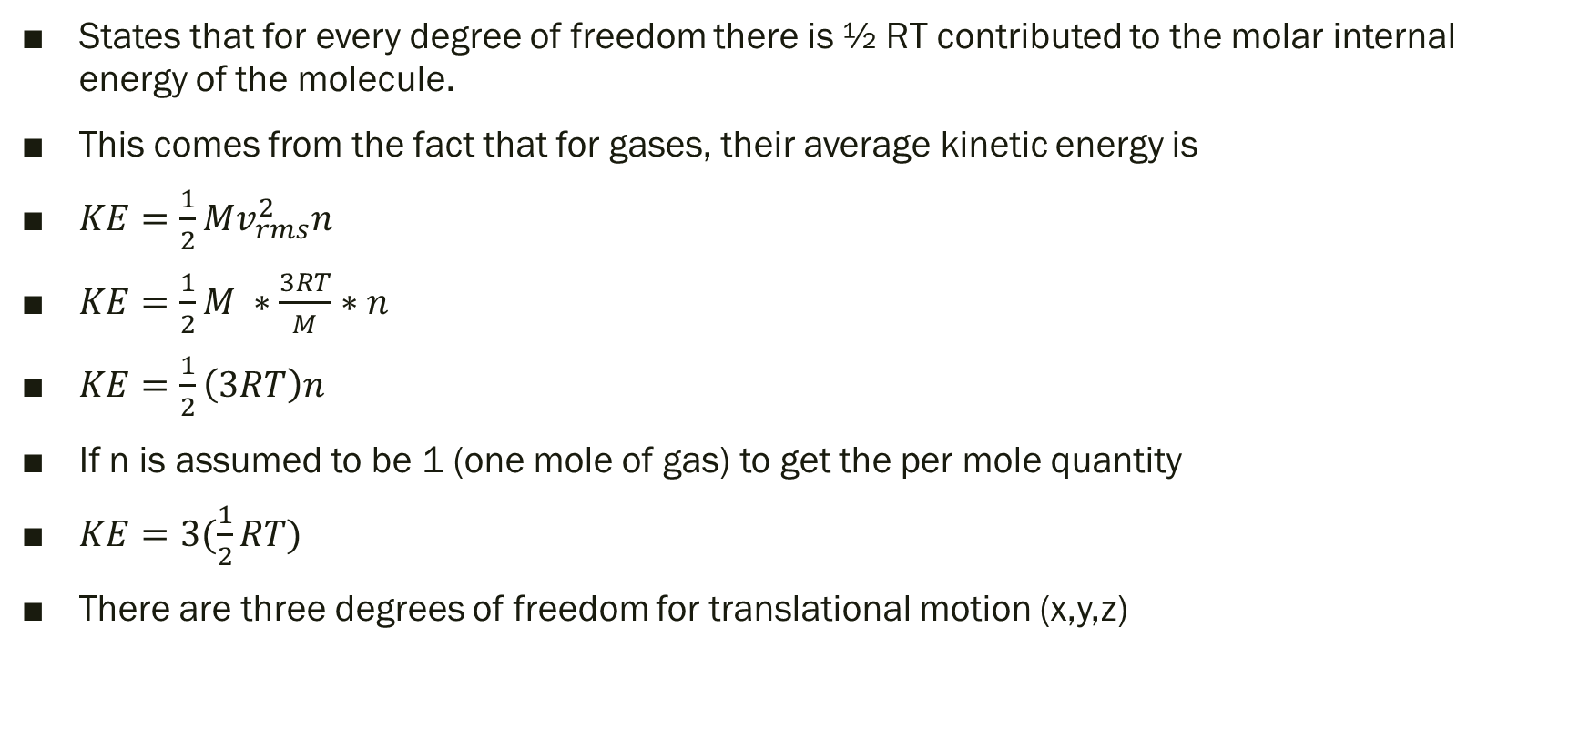
Equipartition Theorem
States that for every degree of freedom there is ½ RT contributed to the molar internal energy of the molecule.
This comes from the fact that for gases, their average kinetic energy is
$KE=\frac{1}{2}Mv_{rms}^{2}n$
$KE=\frac{1}{2}M ∗\frac{3RT}{M}∗n$
$KE=\frac{1}{2}\left(3RT\right)n$
If n is assumed to be 1 (one mole of gas) to get the per mole quantity
$KE=3(\frac{1}{2}RT)$
There are three degrees of freedom for translational motion (x,y,z)

Slide 15
Degrees of freedom in any molecule
There are 3N degrees of freedom for any molecule where N is the number of atoms.
3 of those 3N degrees is represented by the translational motion of the molecule (x, y, z)
And either 2 or 3 of those 3N degrees are represented by the rotational motion of the molecule.
  For a linear molecule there are only two distinct rotational modes
  For a nonlinear molecule there are three distinct rotational modes (due to lack of symmetry along linear axis)
There is a third means of motion… vibrational…

Slide 16
Vibrational modes
Vibrational modes are unique in that they actually contribute 2 * ½ RT to the total internal energy… why is that so?
  Vibrational modes have two components, a kinetic and potential energy term (obviously if something is vibrating it is moving hence kinetic and bonds as we will see later on in the course are viewed as mass-spring systems so there is a potential energy term associated with it as well)
Because there are two terms associated with it, it contributes two times the amount to the overall internal energy.
There are 3N total degrees of freedom for any molecule, for a linear molecule 3 come from translational and 2 come from rotational therefore there are 3N-5 vibrational modes for linear molecules.
There are therefore 3N-6 vibrational modes for nonlinear molcules.

Slide 17

The molar internal energy for any substance is therefore
$∆U= \sum_{i}{E_{i}=3\left(\frac{1}{2}RT\right)+2\left(\frac{1}{2}RT\right)+2\left(3N−5\right)\left(\frac{1}{2}RT\right)for linear molecule= }3\left(\frac{1}{2}RT\right)+3\left(\frac{1}{2}RT\right)+2\left(3N−6\right)\left(\frac{1}{2}RT\right) for polyatomic molecule$

Slide 18
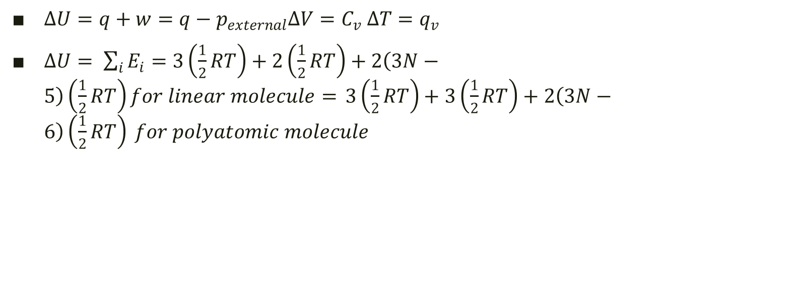
Formulas for Internal Energy
$∆U=q+w=q−p_{external}∆V=C_{v} ∆T=q_{v}$
$∆U= \sum_{i}{E_{i}=3\left(\frac{1}{2}RT\right)+2\left(\frac{1}{2}RT\right)+2\left(3N−5\right)\left(\frac{1}{2}RT\right)for linear molecule= }3\left(\frac{1}{2}RT\right)+3\left(\frac{1}{2}RT\right)+2\left(3N−6\right)\left(\frac{1}{2}RT\right) for polyatomic molecule$

Slide 19
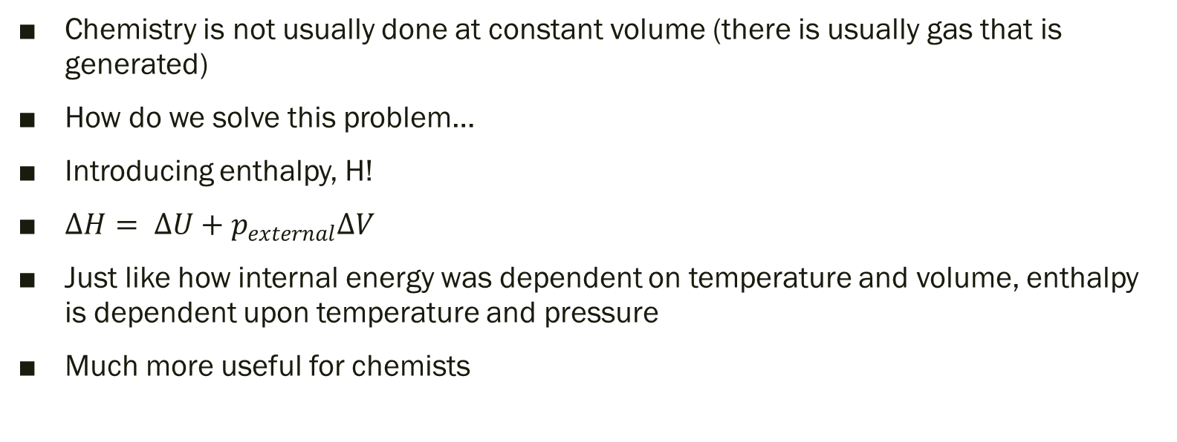
What is Enthalpy?
Chemistry is not usually done at constant volume (there is usually gas that is generated)
How do we solve this problem…
Introducing enthalpy, H!
$∆H= ∆U+p_{external}∆V$
Just like how internal energy was dependent on temperature and volume, enthalpy is dependent upon temperature and pressure
Much more useful for chemists

Slide 20

Analogies of Internal Energy and Enthalpy
Internal Energy terms: Enthalpy terms:
$∆U=q−p_{external}∆V$ $∆H= ∆U+p_{external}∆V$
$∆U=C_{v} ∆T$ $∆H= C_{p}∆T$
$∆U=q_{v}$ $∆H=q_{p}$
$dU={\left(\frac{∂U}{∂V}\right)}_{T}dV+{\left(\frac{∂U}{∂T}\right)}_{V}dT$ $dH={\left(\frac{∂H}{∂P}\right)}_{T}dP+{\left(\frac{∂H}{∂T}\right)}_{P}dT$

Slide 21
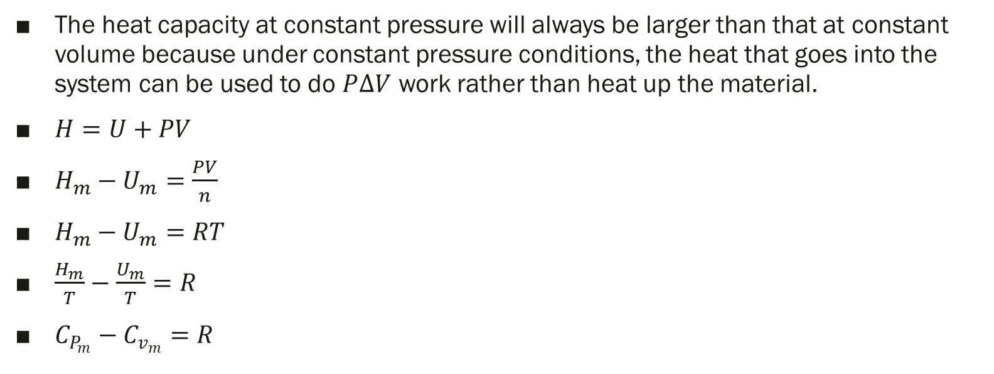
Relationship between the two heat capacities
The heat capacity at constant pressure will always be larger than that at constant volume because under constant pressure conditions, the heat that goes into the system can be used to do $P∆V$ work rather than heat up the material.
$H=U+PV$
$H_{m}−U_{m}=\frac{PV}{n}$
$H_{m}−U_{m}=RT$
$\frac{H_{m}}{T}−\frac{U_{m}}{T}=R$
$C_{P_{m}}−C_{v_{m}}=R$

Slide 22
Are enthalpy and internal energy state functions?
Yes they are, they only depend upon the initial and final states. This is critical as we will see later with Kirchoff’s law.

Slide 23
Hess’s Law
States that the change in enthalpy for the reaction is equal to the summation of the changes in enthalpy for the individual steps.
This law works because enthalpy is a state function, it does not matter if you do a reaction in one fell swoop or in teeny tiny increments, it is all the same for enthalpy.

Slide 24
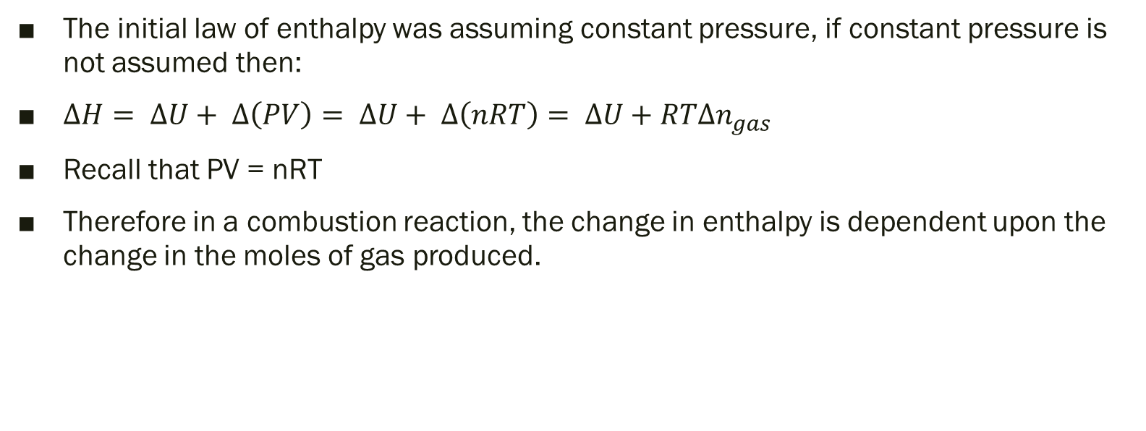
Combustion
The initial law of enthalpy was assuming constant pressure, if constant pressure is not assumed then:
$∆H= ∆U+ ∆\left(PV\right)= ∆U+ ∆\left(nRT\right)= ∆U+RT∆n_{gas}$
Recall that PV = nRT
Therefore in a combustion reaction, the change in enthalpy is dependent upon the change in the moles of gas produced.

Slide 25
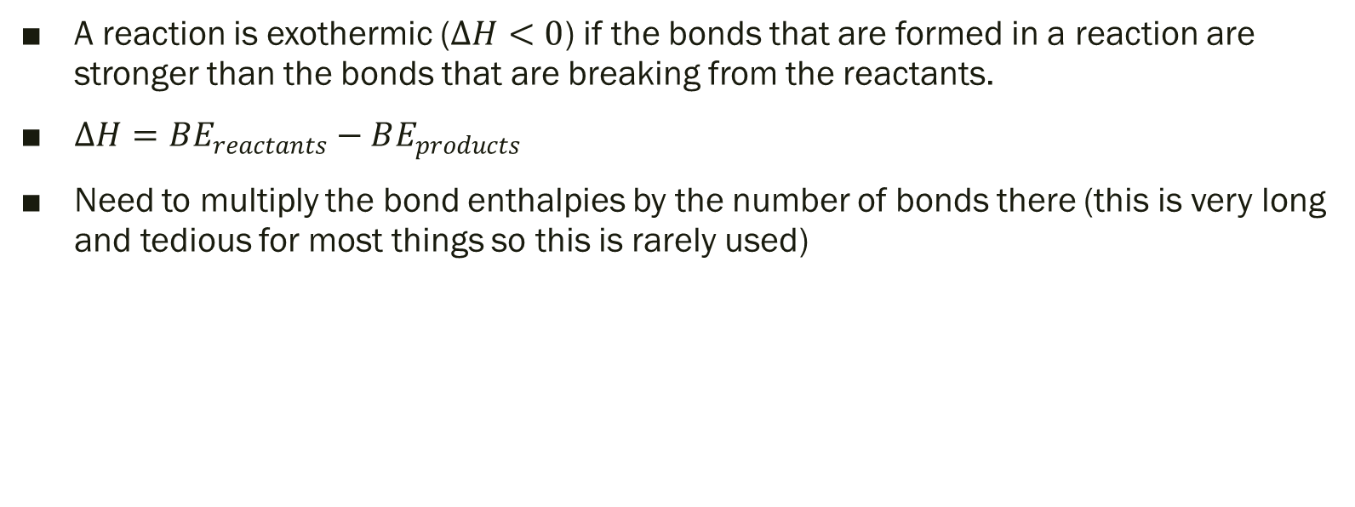
Bond Energies
A reaction is exothermic ($∆H<0$) if the bonds that are formed in a reaction are stronger than the bonds that are breaking from the reactants.
$∆H=BE_{reactants}−BE_{products}$
Need to multiply the bond enthalpies by the number of bonds there (this is very long and tedious for most things so this is rarely used)

Slide 26
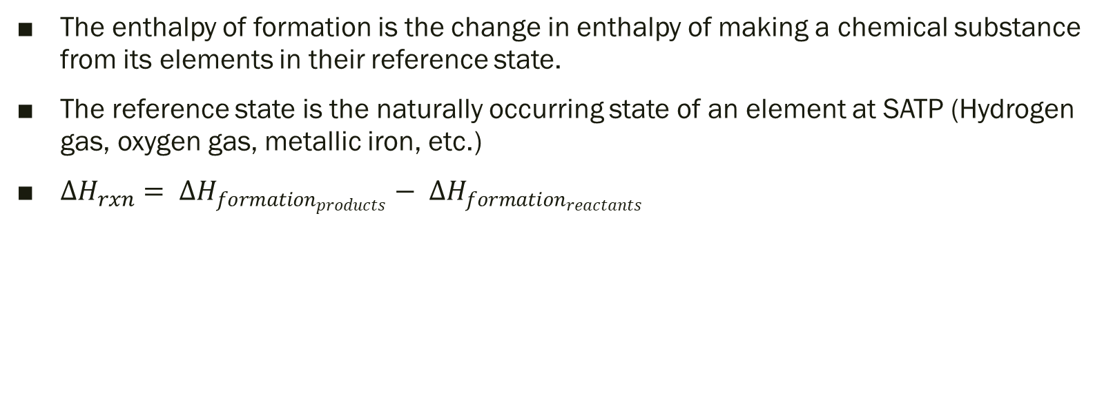
Enthalpy of formation
The enthalpy of formation is the change in enthalpy of making a chemical substance from its elements in their reference state.
The reference state is the naturally occurring state of an element at SATP (Hydrogen gas, oxygen gas, metallic iron, etc.)
$∆H_{rxn}= ∆H_{formation_{products}}− ∆H_{formation_{reactants}}$

Slide 27
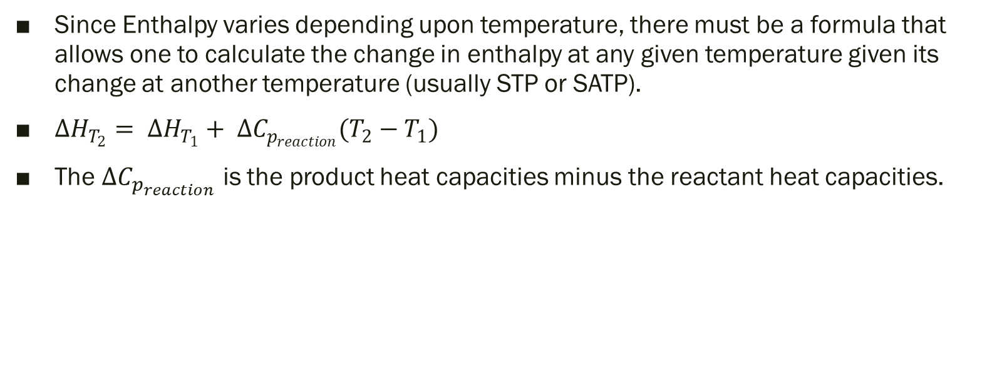
Kirchoff’s Law
Since Enthalpy varies depending upon temperature, there must be a formula that allows one to calculate the change in enthalpy at any given temperature given its change at another temperature (usually STP or SATP).
$∆H_{T_{2}}= ∆H_{T_{1}}+ ∆C_{p_{reaction}}(T_{2}−T_{1})$
The $∆C_{p_{reaction}}$ is the product heat capacities minus the reactant heat capacities.

