Slide 1
Foundations of Physical Chemistry: Chapter 1: Gas Laws
NeighborhoodGeeks

Slide 2
Foundational Definitions and Terms
Adiabatic = a process in which no heat is exchanged, $q=0J$
Isothermal = a process in which temperature remains constant $∆T=0K$
Isobaric = a process in which pressure remains constant $∆P=0Pa$
isovolumetric= a process in which volume remains constant $∆V=0L$
Equation of state = an empirical equation that describes a particular chemical system (not all combinations of physical quantities are physically possible)
Open system = a system in which energy and matter(material) can be exchanged i.e. a test-tube with an open top
Closed system = a system in which energy, but not matter can be exchanged i.e. a closed-top test-tube
Isolated system = a system in which neither energy nor matter can be exchanged i.e. a really good thermos.

Slide 3
Frequent Unit Conversions
$1mL=1 cm^{3}={10}^{−3}dm^{3}={10}^{−3}L$
$1 atm=101325 Pa=101.325 kPa=1.01325 bar$
$1 Pa=1\frac{N}{m^{2}}$
$K=273.15+C$

Slide 4
Ideal Gas Law
Fundamental assumptions:
All collisions between molecules are elastic (momentum and KE are conserved)
Molecules take up no volume
There are no attractive forces between molecules in the gas phase
When are these assumptions valid?
High temperature (minimizes the effect of attractive and repulsive forces of molecules)
Low pressure (minimizes the chance of collision and minimizes forces between molecules)

Slide 5
Why is it so important?
It explains the fundamental gas laws that you learned in General Chemistry
PV = nRT
PVm = RT
Vm = V/n or the molar volume of a gas
P1V1 = P2V2 if T and n stay the same because R is a constant
P1/T1 = P2/T2 if V and n stay the same because R is a constant
P1V1/T1 = P2V2/T2 if n stays the same because R is a constant
If you don’t believe this then isolate the ideal gas law for one side

Slide 6
But what about real gases?
Though the ideal gas law works well for most gases at SATP (standard ambient temperature and pressure [23 C at 1 atm])
It does not work well for gases at low temperature and high pressure because those conditions will maximize collisions between gas molecules and maximize the intermolecular forces between gas molecules which is not good.

Slide 7
Introducing the Van Deer Waals Equation
Introduces two terms:
a = represents the attractive/repulsive forces between molecules
b = represents the excluded volume introduced per mole of gas molecules
$\left(P+a {\left(\frac{n}{V}\right)}^{2}\right)\left(V−nb\right)=nRT$
Because the b term relates to the excluded volume, it is related to the volume of the gas molecule
$b=4V_{molecule}N_{a}$

Slide 8
Introducing the Virial Equation of State
The Van Deer Waals Equation is great, but it has its shortcomings (it is not valid for a wide variety of temperatures)
We can do better… the Virial Equation of State
The virial equation of state has its foundation in what is known as the compressibility factor (Z)

Slide 9
What is the Compressibility Factor
The compressibility factor, Z, represents the ratio of the actual molar volume to the ideal gas molar volume at the same temperature and pressure.
The actual real gas can have either larger or smaller molar volume than the ideal gas depending upon the dominant forces in the gas (attractive means smaller, repulsive means bigger).
The molar volume will henceforth be referred to as Vm from now on
$Z=\frac{V_{m}}{V_{m_{ideal}}}$

Slide 10
What Is The Compressibility Factor Cont.
What is the molar volume of an ideal gas tho?
$Z=\frac{V_{m}}{V_{m_{ideal}}}=\frac{V_{m}}{\frac{RT}{P}}=\frac{V_{m}P}{RT}$
This compressibility factor can be written as a power series in Vm
$Z=1+\frac{B}{V_{m}}+\frac{C}{V_{m}^{2}}+…$
This now yields the more accurate equation of state:
$P=\frac{nRT}{V} ( 1+\frac{nB}{V}+\frac{n^{2}C}{V^{2}}+…)$

Slide 11
Can we relate the two real equations of state?
Yes, the Van Deer Waals parameters can be related to the Virial parameters (specifically the second virial coefficient, B)
$B=b−\frac{a}{RT}$
Usually the Virial equation works well enough to where any term passed B is irrelevant, therefore the conditions where B = 0 would be when the gas behaves most ideally
The temperature at which this occurs is referred to as the Boyle temperature, $T_{boyle}=\frac{a}{Rb}$
(substituting in B = 0 into the above equation)

Slide 12
Behavior of gases during expansion
It was noted that most gases during expansion into a vacuum cool down. Why do you think this is? This is the premise of the Joule-Thompson experiment.
For most gases, Z<1 which means attractive forces dominate. If attractive forces dominate, that means it requires some energy to make the molecules expand (hence the gas cools, kinetic energy goes down).
For some gases (such as Hydrogen), their Z>1 which means they heat upon expansion, this is a problem because hydrogen is kind of explosive…

Slide 13
Joule-Thompson Coefficient
The rate at which temperature changes with pressure changes at constant enthalpy is denoted as the joule-Thompson coefficient.
Usually this is negative for most gases since most gases decrease in temperature.
$μ_{JT}={\left(\frac{∂T}{∂P}\right)}_{H}$

Slide 14
Kinetic Theory of Gases
Gases can be thought of as molecules that are constantly moving around their containers and that pressure is the result of these molecules colliding with the walls of the container.
Therefore P can be related to the root mean square speed , the molecular weight, the number of moles of gas, and the volume of the gas
$P=\frac{nRT}{V}=\frac{nMv_{rms}^{2}}{3V}$
$v_{rms}= \sqrt{{(v}_{1}^{2}+v_{2}^{2}+…)/N} = \sqrt{\frac{3RT}{M}}$

Slide 15
Average Speed of Gas Molecules and Mean Free Path
The average speed of gas molecules is different from the root mean square speed because the RMS represents the kinetic energy of the molecules in the container (that is why T is not in the kinetic energy model pressure equation).
$v_{mean}=\frac{v_{1}+v_{2}+v_{3}+…}{N}= \sqrt{\frac{8RT}{πM}}$
The mean free path is the average distance a molecule of gas will travel before a collision (usually extremely small), lambda
$λ=\frac{kT}{\sqrt{2} σp}$

Slide 16
Molecular Collisions
The mean free path is dependent upon a parameter, sigma,
$σ= πd^{2}$
The frequency of a collision is represented as z
$z=\frac{2σp}{kT} {\left(\frac{8RT}{πM}\right)}^{1/2}=v_{avg}/λ$

Slide 17
What are Probability Density Functions?
This is just a big word for a very simple concept, probability density functions (PDF’s) are functions that when integrated give you the probability of being in between the limits of the integral.
PDF’s are normalized so that the integral over all space (all possible values of x) will give you 1 (since the probability of being any value of x is 1)
PDF’s are continuous and smooth curves
They come up quite often both in Thermodynamics and especially in Quantum Mechanics

Slide 18
Maxwell-Boltzmann Molecular Speed Distribution
The Maxwell-Boltzmann Molecular Speed Distribution is a probability density function (PDF) that represents the probability of being a particular speed at a particular temperature.
$p\left(v\right)=4π {\left(\frac{M}{2πRT}\right)}^{\frac{1}{2}}v^{2}e^{−\frac{Mv^{2}}{2RT}}$
Higher temperatures and lower molecular weights push graph to be flatter and shift right
From this equation one can derive the most likely speed a particle would be at:
$V_{mp}= \sqrt{\frac{2M}{RT}}$

Slide 19
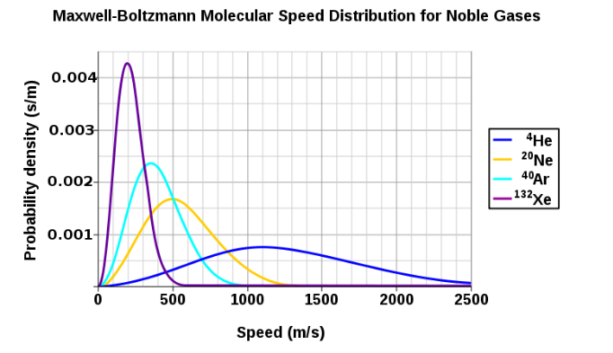
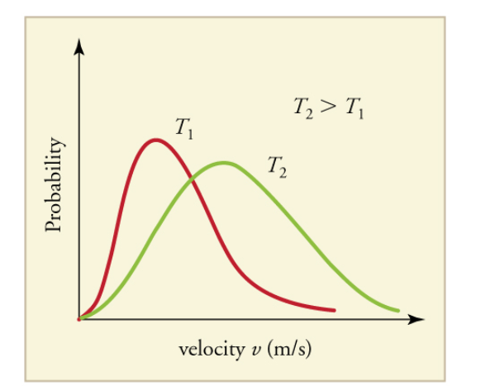

Slide 20
Grahm’s Law of Effusion
When gases escape a vessel through a small hole, this process is called effusion. The rate at which two gases will effuse relative to each other is given to use by Grahm’s law
$\frac{Rate_{gasA}}{Rate_{gasB}}= \sqrt{\frac{M_{B}}{M_{A}}}$

